Slide 1

Title IX
Session 6: Informal Resolution
Presented by: Liz Lavoie

Slide 2

Agenda & Learning Outcomes
Regulations Refresher - When can we use Informal Resolutions
Key Terms
Conflict Styles
Identify Models of Informal (conflict) Resolutions
Group Think
Future Sessions on Informal Resolutions

Slide 3

Refresher: Informal Resolution
Allowable at the institutions discretion
Facilitators conducting informal resolutions must be well trained
Ability to offer and facilitate informal resolution options, such as mediation, or restorative justice, so long as:
Both parties give voluntary, informed, written consent to attempt informal resolution
Institution has to agree

Slide 4
Refresher: Informal Resolution Cont’d
Institutions may not require as a condition of enrollment of continuing enrollment, or employment or continuing employment, or enjoyment of any other right, waiver of the right, to a formal investigation and adjudication of formal complaints of Title IX sexual harassment.
An informal resolution can only be offered after a formal complaint is filed.
At anytime prior to agreeing to a resolution, any party has the right to withdraw from the informal resolution process and resume the grievance process with respect to a formal complaint
Institutions must not offer or facilitate an informal resolution process to resolve allegations that an employee sexually harassed a student.

Slide 5
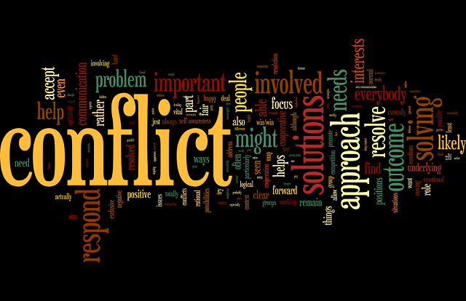
What is Conflict?
“Conflict is interaction among parties who are interdependent and perceive incompatibility with one another. It is important to recognize that conflicts can be driven by perceptions, not merely by the objective situation” (Folger, Joseph P., et al., 2009, p. 11).

Slide 6
Key Terms
Differentiation is a key component of conflict resolution. Without a clear understanding of each party’s position a successful resolution will be hard to achieve. Once opposing stances or positions are made known – the actual work of the conflict can begin
Escalation: Differentiation can also bring tension/escalation as the position each party holds comes to the surface as individuals personalize the conflict. Instead of addressing the real issue it can spiral out of control as emotions run high – this is more common in interpersonal relationships where the relationship becomes a cycle of arguing and anger

Slide 7
Some Key Terms Cont’d
In addition, Avoidance can also interfere with the conflict resolution. One or both parties could avoid discussion or refuse to approach topics that might cause confrontation
This can be harmful to the resolution process leaving one of both parties feeling hurt, angry, or dissatisfied with any outcome
Rigidity can also come into play as differentiation can cause anxiety and fear causing a party to react in a counter-productive way; causing the party to disengage and flee or create further escalation of the conflict

Slide 8
Key Terms Cont’d
For conflict resolution to be effective - the parties must openly agree and realize that they cannot personalizing the other party’s views. This is when the integration phase begins. This provides opportunity for each party to find commonalities that they both can agree upon
Both parties should be ready to move towards integration at the same time; otherwise it can cause escalation of conflict if one is not ready to cooperate.

Slide 9
We are a Party to the Process
Technically UMS is a party as we must also agree to:
Informal Resolution
Decorum
Ground Rules
Outcome is agreeable and reasonable for all

Slide 10
Conflict Style/Interaction – Which One Are You?
Compromising
Competing
Problem-Solving
Avoiding
Accommodating
“Assertiveness Behaviors intended to satisfy own concerns”
“Cooperativeness
Behaviors intended to satisfy other’s concerns”

Slide 11

Influences on Conflict Interaction

Slide 12
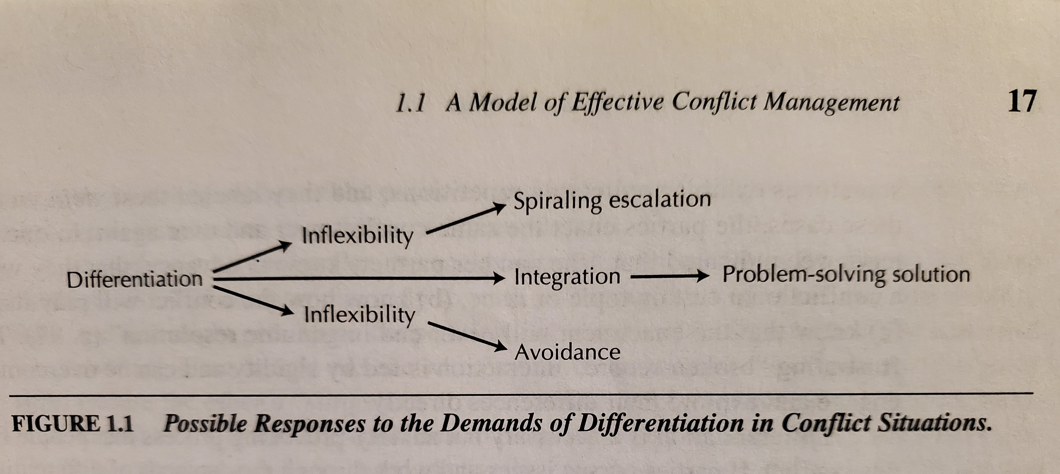
Possible Responses Diagram
Notes:
Overview
The image is a photograph of a flowchart from a textbook page. It illustrates different ways a conflict can develop based on how people respond to "differentiation" (which is the starting point of the chart).
At the top of the page, the section header reads: "1.1 A Model of Effective Conflict Management" with the page number "17" on the far right.
At the bottom of the diagram, the figure caption reads: "FIGURE 1.1 Possible Responses to the Demands of Differentiation in Conflict Situations."
Diagram Structure
The flowchart reads from left to right. It starts with a single point of origin on the left and splits into three distinct paths.
Starting Point: The diagram begins on the far left with the word "Differentiation." Three arrows branch out from this word toward the right, creating a top path, a middle path, and a bottom path.
1. The Top Path:
An arrow points diagonally up and to the right from "Differentiation" to the word "Inflexibility." * From "Inflexibility," another arrow points diagonally up and to the right, ending at the phrase "Spiraling escalation."
2. The Middle Path:
An arrow points straight to the right from "Differentiation" to the word "Integration." * From "Integration," another arrow points straight to the right, ending at the phrase "Problem-solving solution."
3. The Bottom Path:
An arrow points diagonally down and to the right from "Differentiation" to the word "Inflexibility."
From "Inflexibility," another arrow points diagonally down and to the right, ending at the word "Avoidance."

Slide 13
“Interaction Symptoms of Escalation or Avoidance Cycles”
Symptoms of Avoidance
Marked decrease in the parties’ commitment to solving the problem (“Why would we care?”).
Quick acceptance of a suggested solution.
Parties stop themselves from raising controversial aspects of an issue.
People “tune out” of the interaction.
Unresolved issues keep emerging in the same or different form.
Discussion centers on a safe aspect of a broader and more explosive issue.
Little sharing of information.
Outspoken people are notably quiet.
No plans are made to implement a chosen solution.
No evaluation is made of evidence that is offered in support of claims.
Symptoms of Escalation
An issue takes much longer to deal with than was anticipated.
Parties repeatedly offer the same argument in support of a position.
Parties overinflate the consequences of not reaching an agreement.
Threats are used to win arguments.
Mounting tension is felt.
The parties get nowhere but seem to be working feverishly.
Name-calling and personal arguments are used.
Immediate polarization on issues or the emergence of coalitions.
Hostile eye gaze or less-direct eye contact occurs between parties.
Sarcastic laughter or humor is used as a form of tension release.
Heated disagreements seem pointless or are about trivial issues.

Slide 14
Managing Conflict
Normative Model for Conflict Management:
Differentiation is an essential precursor to integration
Preliminary understanding of each other’s issues, interests, and positions
Acknowledge the legitimacy of each other’s issues, interests, and positions, even if they do not agree with them
Realize that the differences cannot be resolved without working together
Have some motivation to resolve the conflict, even if that motivation is only the knowledge that the other party will continue to resist and prolong the conflict unless a mutually acceptable resolution is worked out

Slide 15
Managing Conflict Cont’d
Normative Model for Conflict Management:
Once the differentiation phase have been successfully met, the integration stage can begin
Explore issues and positions; improve understanding and issues; identify underlying problem
Find or identify commonalities or bargain what each person can mutually respect and agree upon
Search for possible solutions
Ideally meet the needs of each party (or something they can live with), while moving towards a solution
Commitment to the solution and keeping their promise of achieving the solution

Slide 16
Creating Shared Attitudes & Decorum
Be clear and logical, avoid arguing your point
This is not about winning or loosing, it’s about agreeing to alternative solutions
Don’t avoid the conflict or become complacent, discuss it in a logical & objective way
Explore viewpoints
Open your mind to viewpoints and see them as organic or productive discussion points
Explore resolution with suspect; determine if similar outcomes would occur as rightful solutions or reasonable agreements
See the process as a collaborative not as an I process
Be respectful, avoid insults, and disrespect

Slide 17
Strategy for Managing Conflicts - Issue Identification:
Implementation
Solution Evaluation & Selection
Solution Generation
Visions
Issue Identification

Slide 18
Other Models for Third Party Resolutions
Orientation
Background Information
Issue Processing
Proposal Development
Model 1 (Donohue, 1991)

Slide 19
Other Models for Third Party Resolutions
Problem-Solving
Storytelling
Introduction
Resolution
Model 2 (Domenici & Littlejohn, 2001)

Slide 20
Let’s Process Our Approach
How will you mention this
What types of cases for you are a big NO for you
How will you approach the responding party especially if they are defensive that you sent the NOIA
How can you not take this defensiveness as personal
Will you have one or two people with you
How do you manage other issues – EX: “they only mediate things, they don’t help”

Slide 21
Decorum – Clear Direction
Clear that this is not a competition of who is right or wrong
Clear that this is not an “all for one” session
Clear that everyone agrees and can the process can stop at anytime
Clear expectations:
No aggressive tones
No standing up towering over someone
No physical actions PERIOD
Breaks are okay to take if you need a moment
No recordings or pictures
No required
Private – can’t be used against the other person if switched to a formal complaint
What else

Slide 22
Redirecting
In the pre-hearing meeting you should have asked how you will tell
Reiterating ground rules
Offering a break
Taking a moment to unpack what is being said
Let silence be, don’t interrupt it
Acknowledge the courage and stress of the moment

Slide 23

Be Prepared to Redirect

Slide 24
Whatch a Pro

Slide 25
Ground Rules –Pre-meeting with Parties (separately)
Using I statements and not blaming words
It’s okay to have feelings (including tears)
It’s okay to take a moment and have time to gather your thoughts
Should they write a statement or no
How will you know their cues
We are not “unpacking” the whole house, just the suitcase
What are each persons goals
“Virtual baton”
Who will talk first
Where will it happen at
What if there is not an reasonable solution for all

Slide 26
Pre-meeting

Slide 27
Decorum

Slide 28
Ground Rules

Slide 29

Free Webinar
August 7th at 12:00pm & August 12th at 3:00pm
See the link that Nina sent on Friday, July 31, 2020 to register.

