Slide 1

Title IX
Session 3: Determining the Correct Procedure to Utilize
Presented by: Liz Lavoie

Slide 2


Agenda & Learning Outcomes
Ability to understand and identify which procedure to utilize and under which policy

Slide 3
Refresher on Title IX Regs
Types of Title IX Sexual Harassment
Must Dismiss under Title IX
Any instance of quid pro quo harassment by a school employee*
Any instance of sexual assault (defined by Clery), dating violence, domestic violence, or stalking (defined by VAWA statute). These statutory definitions are somewhat different from the current definitions in UMS Policies and the Conduct Code, which are from the Clery regulations.*
Unwelcome conduct that a reasonable person would find so severe, pervasive, and objectively offensive that it denies a person equal educational access (Davis Definition)
The conduct alleged in the formal complaint does not meet the definition of Title IX sexual harassment
Did not occur in the school’s education program or activity
Did not occur in the United States
*The final rule notes that incidents of quid pro quo harassment and the Clery/VAWA offense do not have to be evaluated for severity, pervasiveness, offensiveness, or denial of equal education access, because such misconduct sufficiently deprives a person of equal access.

Slide 4
Sexual Harassment Occurring in a School’s Education Program or Activity
Applies to persons in the United States and Federally funded education programs or activities.
Schools must respond to sexual harassment when it occurs in the United States and in the school’s education program or activity.
Education program or activity includes locations, events, or circumstances over which the school exercised substantial control over both the respondent and the content in which the sexual harassment occurred. Includes any building owned or controlled by an officially recognized student organization (ex: Greek Life)
If these criteria are not met – then we follow our traditional SCC and EOCP

Slide 5
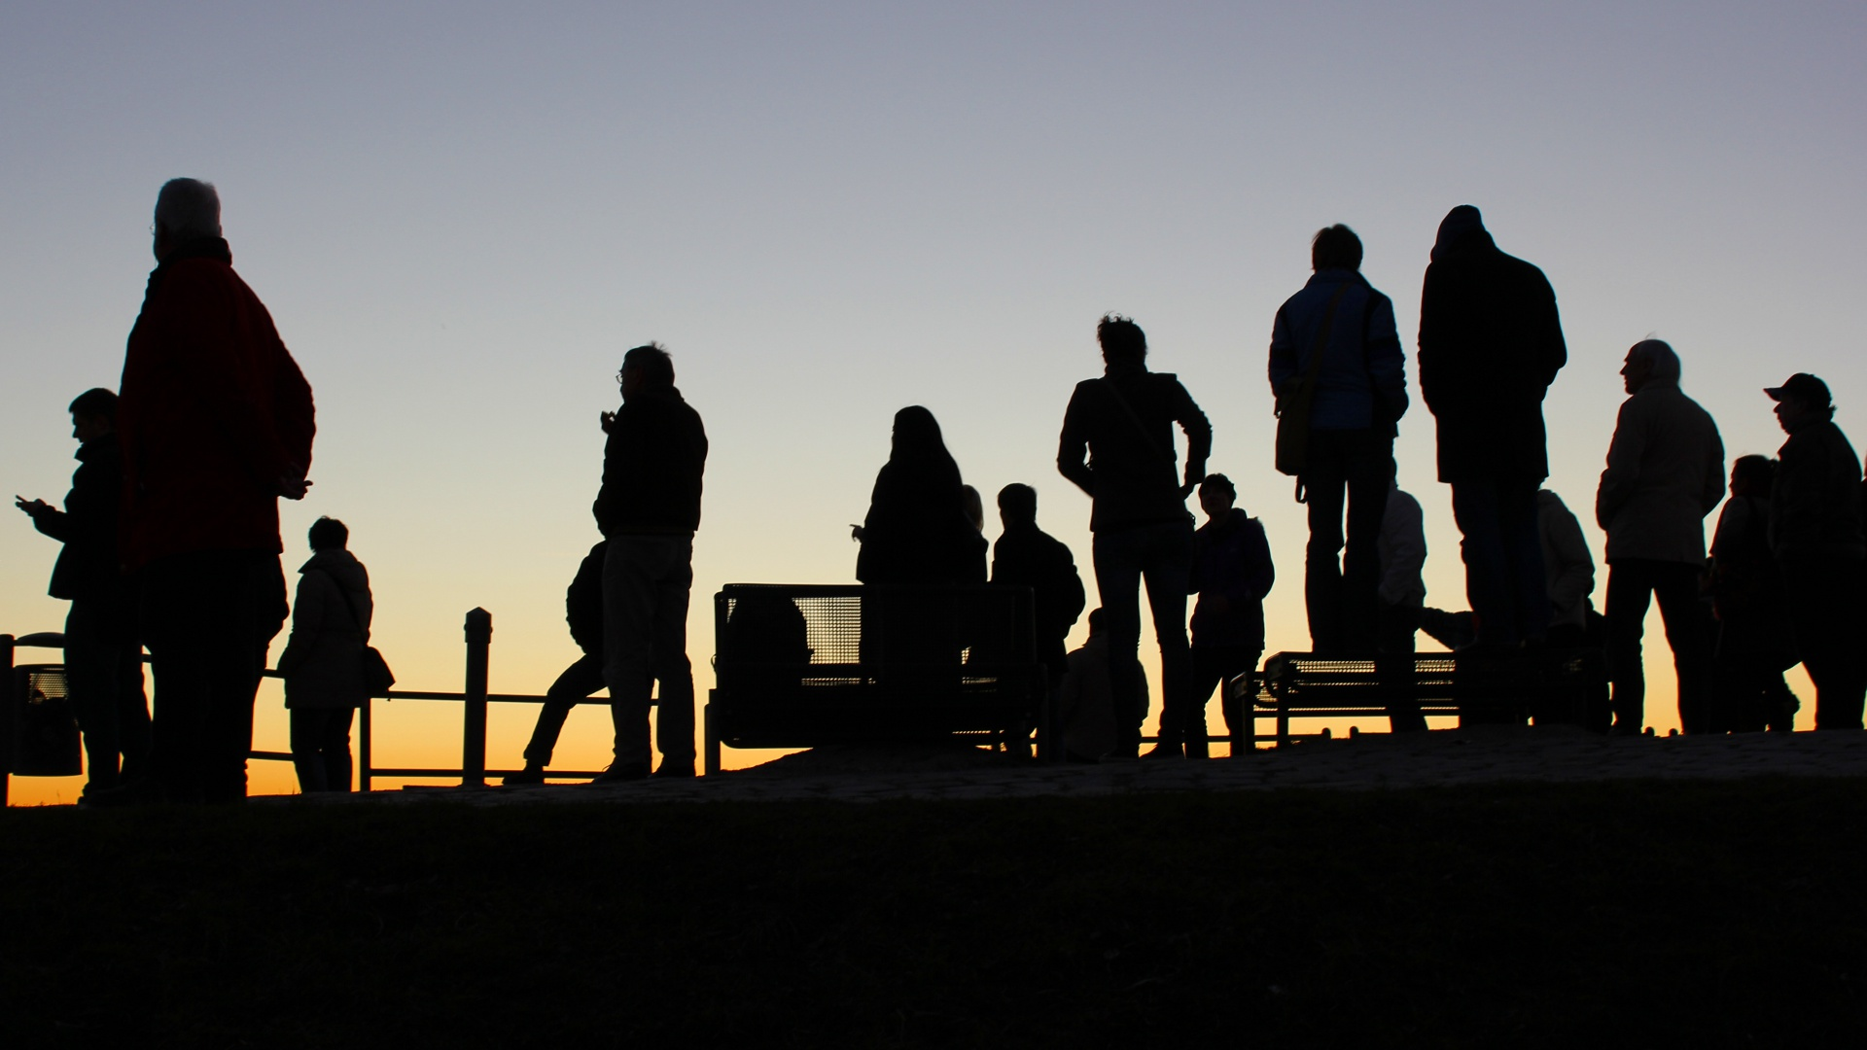
Mandatory Reporting Response Obligations Definitions
Complainant – an individual who is alleged to be the victim of conduct that could constitute sexual harassment
Respondent – an individual who has been reported to be the perpetrator of conduct that could constitute sexual harassment

Slide 6

Mandatory Reporting Response Obligations Definitions Cont’d
Formal Complaint – document filed by a complainant or signed by the Title IX Coordinator alleging sexual harassment against a respondent and requesting an investigation of the allegation of sexual harassment

Slide 7
Mandatory Reporting Response Obligations Definitions Cont’d
Supportive Measures – are individualized services reasonable available that are non-punitive, non-disciplinary, and not unreasonable burdensome to the other party while allowing for equal educational access, safety protections, and/or to deter sexual harassment
Supportive measures and remedies are based on what is reasonable in light of circumstances, is not used to second guess the institution's disciplinary decisions, but requires the institution to offer supportive measures, and provide remedies to a complainant whenever a respondent is found responsible

Slide 8

Informal Resolution
Allowable at the institutions discretion
Facilitators conducting informal resolutions must be well trained
Ability to offer and facilitate informal resolution options, such as mediation, or restorative justice, so long as:
Both parties give voluntary, informed, written consent to attempt informal resolution

Slide 9
Case Study A - Morabo
Morabo is a first year, second semester student.
Morabo speaks with their RA/CA regarding a situation that occurred last semester
Morabo stated that they were drinking and smoking at an off campus Phi Vimle Phi party and Kivik brought them home
Kivik spent the night in Morabo’s dorm room
Kivik was going to sleep on the floor but Morabo woke up to Kevik fondling them
Morabo’s roommate came home and Kivik immediately got up and left.
Morabo has class with Kivik and they have to work together on a group project

Slide 10
Morabo Cont’d
Is not sure if they want to file a formal complaint
Does not want to be in the same class or group project with Kivik
Morabo is having difficulty living in their dorm room this semester as it is the same room as last semester
Morabo is thinking about leaving school
Morabo has not spoken to Kivik and once they were assigned to group Morabo stopped attending class

Slide 11
ATIXA
ATIXA Jurisdictional Rubric Online Tool

Slide 12
Case Study B - Vimle
Vimle is an adjunct professor in psychology
Vimle is new to the area and goes out with some colleagues for drinks
Vimle begins developing a close relationship with one of the tenured professors in the department
Vimle gets a message from the Dean asking Vimle to assist in Karlstad’s research grant
Vimle is excited as they feel like Professor Karlstad is a great mentor
Vimle would love to be a full time faculty member and feels this will add to their resume

Slide 13
Case Study B – Vimle Cont’d
Karlstad sees a lot of potential in Vimle and is very interested in Vimle’s ideas and values
Karlstad is glad to have Vimle join their research
Karlstad and Vimle have many coffee breaks and lunch’s together discussing personal stories, work, and a variety of things
Vimle begins to develop strong feelings for Karlstad
One evening as Karlstad is heading home from work when they run into Vimle
Vimle and Karlstad decide to go out for dinner
After dinner Vimle asks to go home with Karlstad, Karlstad agrees

Slide 14
Case Study B – Vimle Cont’d
Karlstad and Vimle spend the night together and engage in consensual sex
Their relationship continues and they engage in consensual sex at Karlstad’s house off campus several times
Vimle tells another colleague about their relationship with Karlstad, recounting their most recent sexual encounter
This information gets back to Karlstad and they are very upset with Vimle
Karlstad tells Vimle their personal relationship is over and from now on they are to remain working colleagues and nothing more
Vimle is devastated and wishes to file a complaint as they feel they are working in a hostile environment

Slide 15
ATIXA
ATIXA Jurisdictional Rubric Online Tool

Slide 16
Case Study C - Fanbyn
Fanbyn is a first semester senior, living off campus
Fanbyn only has a few courses left to graduate and is looking to apply to graduate school
Fanbyn has a goof relationship with their Advisor and their Advisor has been encouraging them to apply for graduate school
Fanbyn get’s a text message from their Advisor asking to meet
Fanbyn agrees and heads over to their Advisor’s office
The Advisor, Stensele sees great potential in Fanbyn and thinks they would be a great addition to the graduate program at Monsters University

Slide 17
Case Study C – Fanbyn Cont’d
Stensele recently connected with a colleague who has transferred to Monster’s University
Stensele explains to Fanbyn that a colleague who is very well known is not working at Monster’s University
Stensele tells Fanbyn that they would be willing to make a call to their colleague if Fanbyn spent the weekend with them
Stensele tells Fanbyn it would be a send off to remember and that they have already booked a cabin off the coast of Nova Scotia
Fanbyn agrees but is having second thoughts
Fanbyn explains all of this to you and asks what they should do

Slide 18
ATIXA
ATIXA Jurisdictional Rubric Online Tool

Slide 19
Case Study D - Baylow
Baylow is a second semester, first year student majoring in nursing
Baylow’s lab partner constantly talks about the weekends events, going into details of their sex life
Baylow is tires of hearing about it and it is starting to make them feel uncomfortable
Baylow comes to you to discuss the situation

Slide 20
ATIXA
ATIXA Jurisdictional Rubric Online Tool

Slide 21
Case Study E – Effie
Effie is taking an online class and goes to campus to study twice a week
Every time Effie has gone to campus they run into two other people who always comment about Effie’s appearance
The two individuals are students but not in Effie’s online class
Effie has told them to stop but it has continued for the last three weeks
Today Effie went to campus and the two individuals said some sexual comments about her gender identity
Effie reports these interactions to the Deputy Title IX Coordinator

Slide 22
ATIXA
ATIXA Jurisdictional Rubric Online Tool

Slide 23
Case Study G – Porter
Porter is high school senior who is interested in attending the University
Porter alleges they were sexually assaulted by Sorinella last summer before Sorinella enrolled in the University
Porter reports this information to you

Slide 24
ATIXA
ATIXA Jurisdictional Rubric Online Tool

Slide 25
Case Study H – Wyndahl
Wyndahl is a second semester, Junior and decided to take a course that has a travel component to it
Wyndahl finishes the lecture portion of the courses and attends the travel abroad portion with the faculty member and 22 other students
Wyndahl and some other students are exploring the nightlife near their hostel house
Wyndahl goes to a bar with 7 other students
While at the bar Wyndahl grabs the breast and butt of another student
The other student reports this to the faculty member the next morning
You then get a call from the faculty member later that day

Slide 26
ATIXA
ATIXA Jurisdictional Rubric Online Tool

Slide 27
Case Study I – Paxberry
Paxberry is a staff member who works with a lot of students
Paxberry recently ran into one of their students at a local restaurant and bought a couple rounds of drinks and chatted with the students
All the students were of age
Paxberry disclosed that they had a crush on a coworker to the students while they were feeling tipsy and sharing conversation
The next week Paxberry noticed that this coworker was avoiding them and thought it was odd
Paxberry then realized the student had disclosed to their coworker that Paxberry had a crush on them
Paxberry would like to file a complaint with you

Slide 28
ATIXA
ATIXA Jurisdictional Rubric Online Tool

Slide 29
Case Study J – Caitbrook
Caitbrook came to campus to visit a friend
During the visit Caitbrook was groped by another person while walking in downtown Fort Kent
Caitbrook is thinking about apply to UMFK but now rumors are floating around about her and she is fed up
Caitbrook’s friend told her that three other students keep talking about them and think Caitbrook got what they deserved for dressing the way that they do
Caitbrook knows the names of the three student who have said these things
Caitbrook would like to file a complaint against them

Slide 30
ATIXA
ATIXA Jurisdictional Rubric Online Tool

Slide 31

It’s Time for a Comfort Break!

