Slide 1
Supporting Pregnancy, Parenting, and Related Conditions
NOT FOR DISTRIBUTION
An ATIXA Best Practices Workshop

Slide 2

WELCOME!
Please log in to your ATIXA Event Lobby to access the training slides, supplemental materials, and to log your attendance.
The ATIXA Event Lobby can be accessed by scanning the QR code or by visiting ATIXA Event Lobby
You will be asked to enter your registration email to access the Event Lobby.
Links for any applicable training evaluations and learning assessments are also provided in the ATIXA Event Lobby.
If you have not registered for this training, an event
will not show on your Lobby. Please email events@atixa.org or engage the ATIXA website chat app to inquire ASAP.
NOT FOR DISTRIBUTION
© 2025 Association of Title IX Administrators
2
Notes:
*Note – The formatting in this slide has been altered from the original presentation for accessibility purposes. The content itself has not been altered in any manner.

Slide 3



TNG Strategic Risk Management Solutions Disclaimer
NOT FOR DISTRIBUTION
Any advice or opinion provided during this training, either privately or to the entire group, is never to be construed as legal advice or an assurance of compliance. Always consult with your legal counsel to ensure you are receiving advice that considers existing case law in your jurisdiction, any applicable state or local laws, and evolving federal guidance.
(610) 993-0229 | inquiry@tngconsulting.com | www.tngconsulting.com
3

Slide 4



Introduction
This workshop highlights systems for responding to the needs of pregnant students and employees by providing reasonable modifications consistent with the law and best practices.
NOT FOR DISTRIBUTION
Participants will gain an understanding of when a medical necessity arising from pregnancy or a related condition should be addressed as a temporary medical condition by collaborating with disability/accessibility support services staff.
Our goal today is to provide an in-depth examination of the Title IX regulatory requirements and ATIXA’s recommended best practices for supporting individuals experiencing pregnancy or related conditions.

Slide 5
Content Advisory
The content and discussion in this course will necessarily engage with sexual harassment, sex discrimination, violence, and associated sensitive topics that can evoke strong emotional responses.
ATIXA faculty members may offer examples that emulate the language and vocabulary that Title IX practitioners may encounter in their roles including slang, profanity, and other graphic or offensive language. It is not used gratuitously, and no offense is intended.
NOT FOR DISTRIBUTION

Slide 6
Definitions and Regulatory Requirements
NOT FOR DISTRIBUTION

Slide 7
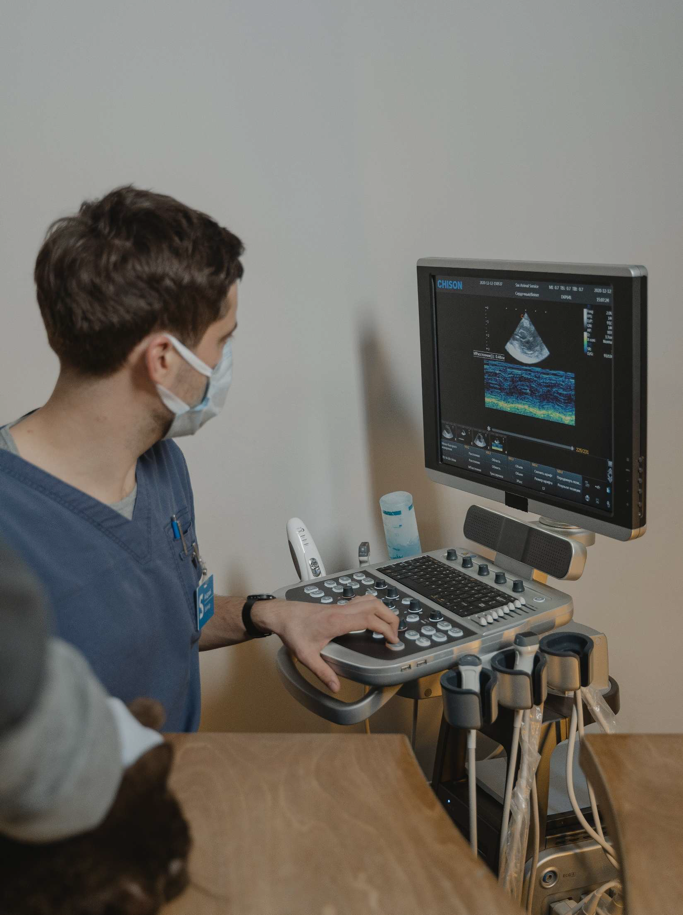
Overview
Pregnant students and employees are protected by Title IX, in addition to other applicable federal and state laws
Ensure that pregnant and newly parenting individuals are supported as needed to access their education and workplace
Ensure individuals know and understand their rights under Title IX, including the role of the Title IX Coordinator (TIXC)
Pregnancy and related conditions are considered from the lens of sex discrimination under Title IX
1975 Regulations apply
NOT FOR DISTRIBUTION

Slide 8
1975 Title IX Regulations
Recipient may not:
Discriminate in its education program or activity against any student or employee based on
Pregnancy
Childbirth
False pregnancy
Termination of pregnancy
Recovery therefrom
Adopt a rule which treats a student or employee differently on the basis of their actual or potential parental, family, or marital status
Applies to applicants for admission and employment
NOT FOR DISTRIBUTION
PWFA and PUMP Act may provide rights and protections for pregnant employees, too

Slide 9
Best Practices: Scope
Individuals and Status:
Students
Employees
Pregnancy and related conditions
Family status
Marital status
Parenting status
“Head of household”
Non-Discrimination Issues:
Financial assistance
Funding
Lactation space and time
Health insurance
Housing
Leaves of absence
Salaries and benefits
Academics and access to course offerings
Admissions
Athletics
Employment, recruitment, and hiring
Extra-curricular activities
Facilities
Externships/clinical placements
NOT FOR DISTRIBUTION

Slide 10
Federal and State Law Overlap
Title IX
EEOC
STATE
OCR
DOL
Title VII of the Civil Rights
Act of 1964
Section 504 of the
PREGNANCY
Rehabilitation Act of 1973
Americans with
NOT FOR DISTRIBUTION
Disabilities Act
DISABILITY
Pregnant Workers
Fairness Act
Family Medical Leave Act
FAMILY/MEDICAL NEEDS
PUMP Act
State Laws
EXPRESSING MILK
BREASTFEEDING
Notes:
The slide uses a visual matrix to map five different categories of accommodations or needs to four specific regulatory bodies/jurisdictions, indicating which specific laws apply in each context.
Regulatory Bodies/Jurisdictions (Columns):
OCR (Office for Civil Rights)
EEOC (Equal Employment Opportunity Commission)
DOL (Department of Labor)
STATE
Categories and Applicable Laws (Rows): The matrix breaks down the overlap as follows:
Pregnancy: * Under OCR: Covered by Title IX.
Under EEOC: Covered by Title VII of the Civil Rights Act of 1964, and the Pregnant Workers Fairness Act.
Under STATE: Covered by State Laws.
Disability:
Under OCR: Covered by Section 504 of the Rehabilitation Act of 1973.
Under EEOC: Covered by the Americans with Disabilities Act.
Family/Medical Needs:
Under OCR: Covered by Title IX.
Under DOL: Covered by the Family Medical Leave Act.
Expressing Milk:
Under OCR: Covered by Title IX.
Under DOL: Covered by the PUMP Act.
Breastfeeding:
Under STATE: Covered by State Laws.

Slide 11
Overlap with State Laws
All but five states have enacted some state-level protections for pregnancy in the workplace
Alabama, Indiana, Nevada, North Carolina, and South Dakota
Forty-two states and Washington, D.C. have state-level protections for pregnancy accommodations
All states; Washington, D.C.; Puerto Rico; and USVI have some law permitting breastfeeding in any public or private location
TIXCs need to be aware of the intersection of these federal and state laws when developing and implementing policy
NOT FOR DISTRIBUTION

Slide 12
Title IX Coordinator & Pregnancy
NOT FOR DISTRIBUTION

Slide 13






Best Practices for TIXC Oversight
Policies, Practices, and Procedures
Documentation
NOT FOR DISTRIBUTION
Resolution Process
Reporting/ Information Sharing
Outreach and Support
Training

Slide 14
Academic Policies and Procedures
TIXC must be well-versed in institutional policies that may have implications for students who are pregnant or have related conditions
Academic Incompletes
Add/Drop
Grade Appeals
Internships/ Externships/
Co-Ops/Practicums
NOT FOR DISTRIBUTION
Leaves of Absence
Out-of-Class Expectations
Pass/Fail Option
Retakes

Slide 15
General Policy Awareness
Non-academic policies may also impact individuals who are pregnant or have related conditions
TIXC should be aware of policies and make themselves available for consultation with those developing and revising policies
NOT FOR DISTRIBUTION
Common Policies
Attendance ▪ Minors on campus
Dress codes ▪ Parking
Financial aid and scholarships ▪ Student health insurance
Housing contracts/live-on requirements ▪ Visa requirements

Slide 16
Granting Exceptions to Policies and Processes
Request process should be clear and well-advertised
Online form or appointment request
Pre-emptive employee training including scenarios and example communications
Consider waivers for arbitrary policies (e.g., no leaves of absence longer than two weeks) even if that results in inconsistency with previous practices
TIXC partners with other offices to implement and provide a seamless support process for students and employees
Retroactive reasonable modifications are not required
Common and often necessary with pregnancy or related conditions
ATIXA recommends developing a framework or rubric to guide consistent retroactive request decisions
NOT FOR DISTRIBUTION

Slide 17

Documentation and Communication
Clear, detailed documentation regarding reasonable modifications is recommended
Obtain written consent prior to disclosing personally identifiable information (e.g., pregnancy status)
Office for Civil Rights (OCR) emphasizes that communication across the institution is key
Consider nuance and employ soft skills to navigate conversations with other departments
NOT FOR DISTRIBUTION

Slide 18
Privacy and Recordkeeping Recommendations
Consult with legal counsel about recordkeeping and sharing practices
Consider whether to maintain records of:
Initial request/contact
Reasonable modification information
Consultation with disability/accessibility services (if applicable)
Notifications
Complaints
Investigations and resolutions
Medical records receive at least the same privacy as other Title IX documents
Limit access accordingly
Note: Education and employment records are subject to subpoena
NOT FOR DISTRIBUTION

Slide 19
Reasonable Modifications
NOT FOR DISTRIBUTION

Slide 20
Reasonable Modifications
The 1975 Title IX Regulations do not require institutions to modify policies or procedures for students or employees on the basis of pregnancy or a related condition
ATIXA recommends using the term reasonable modifications to distinguish support for pregnancy and related conditions from supportive measures for sexual harassment and reasonable accommodations for disabilities
Reasonable Modifications to the Recipient’s policies, practices, or procedures to prevent discrimination:
Individualized: must consult with the individual before offering
Voluntary: individual may accept or decline each reasonable modification offered
Fundamental alteration of education program or activity is NOT reasonable
NOT FOR DISTRIBUTION

Slide 21
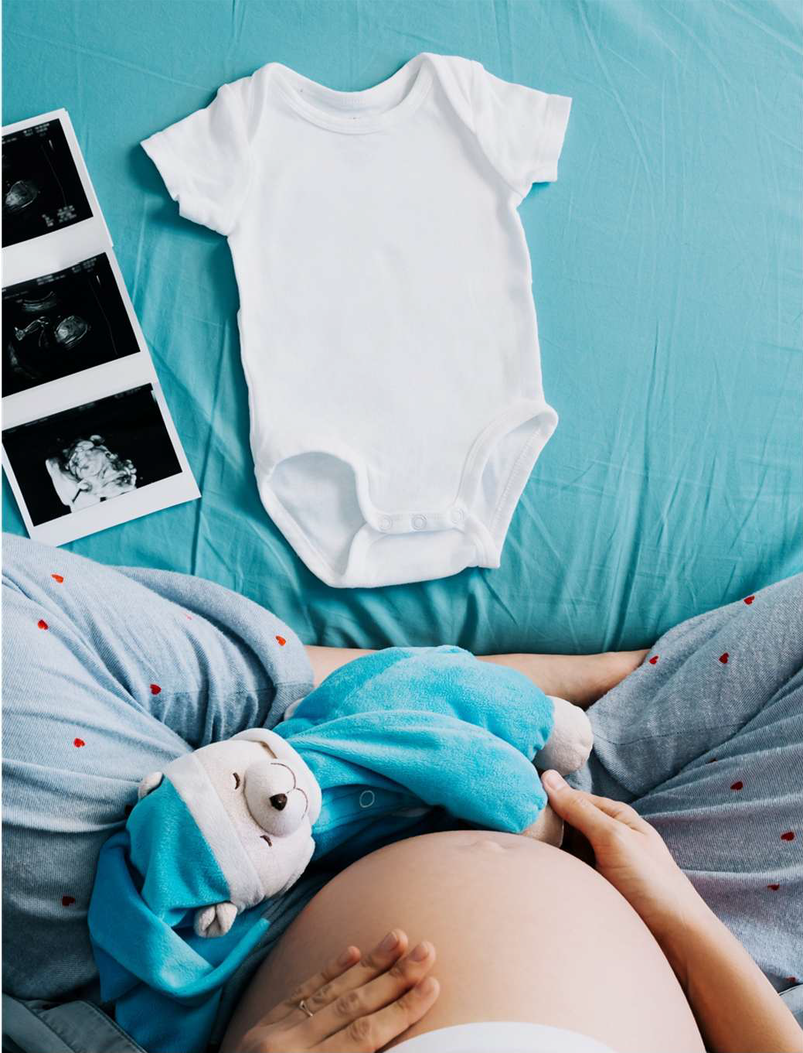
Training and Information Sharing
ATIXA recommends training all employees on:
Sex discrimination on the basis of pregnancy and related conditions
Resources and support available through the TIXC
Information to provide an individual who discloses a pregnancy or related condition
NOT FOR DISTRIBUTION

Slide 22
Outreach and Intake
TIXC should inform the individual of the institution’s obligation to:
Prohibit sex discrimination
Provide reasonable modifications to prevent discrimination
Allow access, on a voluntary basis, to any separate and comparable portion of the institution’s education program or activity
Allow a voluntary leave of absence (resuming from the point where they left off)
Provide information about available lactation space
Maintain grievance process for alleged discrimination
Treat pregnancy as comparable to other temporary medical conditions for medical benefit, service, plan, or policy purposes
NOT FOR DISTRIBUTION

Slide 23
Reasonable Modification Examples
Determine suitable reasonable modifications through an interactive process
Breaks During Academic Activities
Excusing Intermittent Absences
Online or Homebound Participation
Course Flexibility
NOT FOR DISTRIBUTION
Accessing Alternate Parking
Counseling
Adjusting Physical Space
Arranging Elevator Access

Slide 24
Supporting Documentation
Medical documentation is typically unnecessary to determine reasonable modifications
Proceeding based on a student’s self-attestation of their needs will be the least burdensome for the student and enable the institution to promptly meet the student’s needs
Should only be required in limited circumstances when:
Necessary and reasonable under the circumstances to determine:
Reasonable modifications to offer
Other specific actions to take
NOT FOR DISTRIBUTION

Slide 25
Supporting Documentation
Generally, not necessary or reasonable when:
Student’s need is obvious, such as:
Expressing breast milk or breastfeeding
Carrying or keeping water nearby and drinking
Using a bigger desk
Sitting or standing
Taking breaks to eat, drink, use the restroom
Needing a larger uniform
Specific actions are available to students for other reasons without supporting documentation
Not all students have access to healthcare providers or have seen one prior to needing reasonable modifications
NOT FOR DISTRIBUTION

Slide 26
Reasonable Modifications
Approach for pregnant students should be the same as non-pregnant students when considering exclusion from labs, athletics, clinical environments, etc.
Safety-related justifications are often discriminatory
Maintain privacy of the student’s pregnancy status to the extent possible
Complaints alleging failure to provide reasonable modifications would be subject to resolution under institutional procedures for sex discrimination
NOT FOR DISTRIBUTION

Slide 27
Certification to Participate
Must not require health care provider or other certification that the student is
physically able to participate in the program or activity, unless:
The certified level of physical ability or health is necessary for participation;
The institution requires such certification of all students participating; and
The information obtained is not used as a basis for pregnancy-related discrimination
NOT FOR DISTRIBUTION

Slide 28
Voluntary Leaves of Absence (LOA)
Must permit voluntary LOA for, at minimum, the period of time deemed medically necessary by the student’s licensed healthcare provider
May take a LOA under another policy if that policy provides a longer time-period for LOA than medically necessary (Title IX rights remain intact)
Must be reinstated to the academic status, and (as practicable), the extracurricular status they held before LOA
Provide opportunity to make up any work missed
Retaking a semester
Taking part in an online course credit recovery program
Allowing student additional time in a program to continue at the same pace and finish at a later date
Student should be allowed to choose how to make up the work
NOT FOR DISTRIBUTION

Slide 29
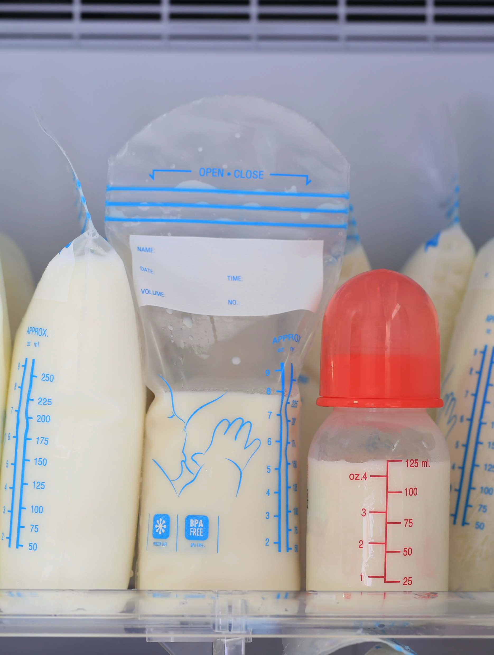
Best Practices: Lactation Time & Space
Ensure student and employee access to a lactation space that is functional, appropriate, and safe:
A space other than a bathroom, that is:
Clean
Shielded from view
Free from intrusion from others
Available for expressing breast milk or breastfeeding as needed
NOT FOR DISTRIBUTION

Slide 30

Pregnancy and Disability Intersection
Pregnancy itself is not a disability under ADA/Section 504 but some pregnancy-related conditions could manifest as temporary disabilities
TIXC should collaborate with disability/ accessibility services staff to determine reasonable modifications for individuals with temporary disabilities
Ensure compliance with Title IX, Americans with Disabilities Act (ADA), and Section 504
NOT FOR DISTRIBUTION

Slide 31
Title IX vs. ADA/Section 504 Obligations
Title IX
Prohibits sex discrimination against students and employees
Provides the student with the option of reasonable modifications
Allows voluntary access to any separate and comparable portion of the program or activity
Allows voluntary leaves of absence
ADA/Section 504
Prohibits discrimination against individuals with disabilities (including temporary ones)
Involved as requested when someone has a physical or mental impairment that substantially limits one or more major life activities
Follows institution’s interactive process to provide reasonable accommodations
NOT FOR DISTRIBUTION

Slide 32
Related Issues
NOT FOR DISTRIBUTION

Slide 33
Pregnancy and Student-Athletes
Pregnant student-athletes must be permitted to participate in athletics without restriction or modification (other than what restrictions are applied to all students)
The National Collegiate Athletics Association (NCAA) is the only collegiate governing body to have a specific policy on pregnant student-athlete participation
Most others follow the NCAA’s lead
TIXC and athletic staff, including coaches, should be familiar with NCAA policy
The majority of high school athletics associations have not adopted policies related to pregnancy
NOT FOR DISTRIBUTION

Slide 34
Key Rights of Pregnant Student-Athletes
Athletics financial aid awards cannot be conditioned on not becoming pregnant and are protected during the term of the award
A student-athlete who has taken leave for pregnancy related conditions must be reinstated
“Misconduct” involving pre-marital sex cannot be used as a justification for limiting a pregnant student-athlete’s participation (subject to religious exemption)
Discrimination prohibitions apply to recruiting
A pregnant student-athlete cannot be retaliated against for reporting or complaining about pregnancy discrimination
NOT FOR DISTRIBUTION

Slide 35
Support for Non-Birthing Parents
Title IX:
Focuses on providing support and resources to reduce disparities in access to the education program
Seeks to remedy the inequities sex discrimination creates
Narrow application to only the birthing or pregnant individual may run afoul of Title IX, if it discriminates on the basis of sex
TIXC may evaluate and determine on an individualized basis if requested modifications are reasonable and appropriate for a non-birthing parent
Can also support without relying on legal requirements
NOT FOR DISTRIBUTION

Slide 36
Parenting
If the institution would provide protections/modifications to a birthing parent, it might be sex discrimination under Title IX to refuse them to the non-birthing parent
Title IX covers attending to:
The pregnancy-related medical needs of the birthing parent
The birth-related immediate post-partum health/medical needs of the child
Length of post-partum leave as determined medically necessary by a healthcare provider
Sick/unhealthy birth parents/children are not otherwise covered by Title IX pregnancy or related conditions protections
NOT FOR DISTRIBUTION

Slide 37
Non-Medical Childcare Needs
Institution not legally required to provide childcare or reasonable modifications for childcare needs
May voluntarily and equitably provide reasonable modifications under institutional policy
Requests for childcare support are usually for excused absences, remote learning options, or access to hybrid work environments
TIXC may choose to evaluate each request case-by-case, considering the proximity of time to the pregnancy, necessity, etc.
Modifications should have clear start and end dates and applicable parameters
NOT FOR DISTRIBUTION

Slide 38


Case Studies
NOT FOR DISTRIBUTION

Slide 39
Case Study Instructions
Break into small groups
Access the case study document in the Course Lobby
Each group will start on their assigned case study and work through as many as possible in 60 minutes
Regroup to debrief on exercise for the remaining time
NOT FOR DISTRIBUTION

Slide 40
Case Study 1: Valerie
Valerie is an incoming first-year student.
She has been awarded a prestigious Hopper Scholarship based on her academic performance and leadership potential.
The Hopper Scholars are a group of 20 students from each incoming undergraduate class selected to receive a full-ride scholarship (tuition, books, room, and board) and participate in a cohort-model program focused on academic excellence and civic engagement.
To maintain their scholarship, Hopper Scholars are required to enroll in a set curriculum, reside on campus in the Hopper Scholars living-learning community, and engage in leadership development and civic engagement opportunities planned by the Hopper Scholars advisor in conjunction with the institution’s President who established the program.
Prior to arriving to the institution for her first term, Valerie learns that she is pregnant, and her due date is in late March of the following year.
NOT FOR DISTRIBUTION

Slide 41
Case Study 1: Valerie
Valerie emails the Hopper Scholars advisor to inquire about her options for continuing with the program now that she is pregnant.
The advisor informs Valerie that she will be unable to participate in the program and her scholarship will be revoked because she cannot live in on-campus housing with a child and residing in the living-learning community is an essential component of the scholarship program.
Shocked and panicked because she knows she will be unable to attend the institution without her scholarship, Valerie contacts the Title IX office for assistance.
NOT FOR DISTRIBUTION

Slide 42
Case Study 1: Valerie
If these conditions are true, would revoking Valerie’s scholarship be considered discrimination on the basis of sex under Title IX?
Why or why not?
What immediate remedies would be appropriate in this situation?
What long-term remedies should the institution consider?
NOT FOR DISTRIBUTION

Slide 43
Case Study 2: Chemical Concerns
The institution’s Department of Environmental Health and Safety wants to publish a “Pregnancy in the Lab” guide and require all female employees and students who will engage in laboratory activities where hazardous chemicals may be present to sign a waiver releasing the institution from liability for any potential impacts on a pregnancy or difficulty conceiving as a result of hazardous chemical exposure.
Joon Woo, an Environmental Health and Safety employee, advised the Director that he believed such a practice would be considered discriminatory and suggested that they consider a different approach.
The Director dismisses Joon Woo’s concerns and tells Joon Woo to mind his own business or he will no longer be included in department leadership meetings.
NOT FOR DISTRIBUTION

Slide 44
Case Study 2: Chemical Concerns
Joon Woo submits an anonymous report for alleged discrimination to Human Resources through the EthicsPoint portal.
The Director of Human Resources forwards the complaint to you as the Title IX Coordinator.
NOT FOR DISTRIBUTION

Slide 45
Case Study 2: Chemical Concerns
What steps would you take to respond?
What steps can be taken to determine Joon Woo’s identity to follow up on his complaint?
If implemented, would the proposed policy be discriminatory on the basis of sex under Title IX?
Why or why not?
If Joon Woo is no longer included in the department leadership meetings, would that constitute discrimination under Title IX?
Why or why not?
NOT FOR DISTRIBUTION

Slide 46
Case Study 3: Swim Practice
Ellerie is a high school junior and a member of the girls’ varsity swim team.
She gave birth to her first child over the summer between her sophomore and junior years and has been experiencing post-partum depression since the birth.
Swim team practice is scheduled for weekday mornings from 6:00-7:30 AM in the shared natatorium.
Ellerie often finds herself unable to wake up in the morning in time to make it to practice on time or sometimes at all because of her depression.
As a result of her inconsistent attendance at practice, Coach Sumner has pulled Ellerie from three relay races and two individual events for the upcoming regional swim meet.
Ellerie’s parents contacted the district Athletic Director to express their disapproval of Coach Sumner’s decision.
The Athletic Director has reached out to you as the Title IX Coordinator for assistance.
NOT FOR DISTRIBUTION

Slide 47
Case Study 3: Swim Practice
How would you navigate this situation?
If true, would Coach Sumner’s actions be considered discrimination on the basis of sex under Title IX?
Why or why not?
What reasonable accommodations or supportive measures may be appropriate in this situation?
Are there additional remedies that would restore Ellerie’s access to the education program or activity?
NOT FOR DISTRIBUTION

Slide 48
Case Study 4: Cheyenne
Cheyenne is the captain of the dance team that performs at home football and basketball games, school pep rallies, and a variety of other school and community events throughout the year.
They also compete in state-wide and national competitions.
Cheyenne became pregnant shortly after the school year began.
Their doctor has approved them to continue with their full participation in dance team activities.
The dance team uniforms are midriff-bearing, and Cheyenne’s “bump” begins to become noticeable during basketball season.
Cheyenne requests a larger size uniform, and the coach provides another uniform without issue.
NOT FOR DISTRIBUTION

Slide 49
Case Study 4: Cheyenne
However, several parents of other dance team members begin pressuring the coach to remove Cheyenne as dance team captain because they don’t believe that an unwed, teenage mother is an appropriate role model or leader for their daughters.
One parent even created a petition calling for Cheyenne’s removal from the team.
After one performance, a group of dance team members were giggling in the locker room after viewing a TikTok video about Cheyenne at their recent performance.
The video included the caption, “Hey, ho, preggo’s gotta go!”
Cheyenne’s mother doesn’t want her child to feel further ostracized by filing a formal complaint, but she also wants the parents’ behavior to stop and for the school to address the TikTok video.
NOT FOR DISTRIBUTION

Slide 50
Case Study 4: Cheyenne
How would you navigate resolving this situation?
What is the school/district’s authority related to the TikTok video?
What Supportive Measures may be appropriate?
Is Informal Resolution a potential option?
NOT FOR DISTRIBUTION

Slide 51
Case Study 5: Miray
In late January, the international student services program advisor reaches out to you as the Title IX Coordinator about a student concern.
Miray, a junior from Turkey, is studying in the radiation therapy program on an F-1 visa.
This term, Miray is enrolled in four in-person courses: two off-site clinical courses, one lecture course in the radiation therapy program, and one general education lecture course.
The clinical hours are required both for her academic program and for her licensure.
Miray came to speak with the advisor about needing to reschedule two large exams for her general education course later in the semester, as she will be needing to take a leave of absence after she gives birth.
NOT FOR DISTRIBUTION

Slide 52
Case Study 5: Miray
She shared that her first child is due in late March and that she anticipates being out of classes for 2-3 weeks.
Her husband will be present and able to support her with the baby.
Miray also expressed that she is stressed after speaking with the faculty member for her radiation therapy lecture course who told her she would need to abide by the class attendance policy and miss no more than three class sessions.
She has asked for assistance in creating a plan that will allow her to remain in school full-time to maintain her F-1 visa status.
NOT FOR DISTRIBUTION

Slide 53
Case Study 5: Miray
If true, what discriminatory actions are present under the Title IX policy?
What Supportive Measures are available to Miray?
What happens if she cannot return to class after three weeks?
How would you communicate with faculty?
Who else do you need to communicate with in this situation?
NOT FOR DISTRIBUTION

Slide 54
Case Study 6: Fiona
Fiona, a human resources benefits specialist, recently gave birth to her second child.
The infant has developmental delays and is unable to drink from a bottle.
Fiona is requesting to be able to work remotely so that she is available to breastfeed her child on demand.
NOT FOR DISTRIBUTION

Slide 55
Case Study 6: Fiona
Does Title IX protect individuals in Fiona’s situation?
What would you consider when reviewing Fiona’s request?
How would this scenario change if Fiona was a school resource officer or campus police officer?
How would this scenario change if Fiona was enrolled as a student rather than being an employee?
NOT FOR DISTRIBUTION

Slide 56


Questions?
NOT FOR DISTRIBUTION

Slide 57
Credits
ALL ATIXA PROPRIETARY TRAINING MATERIALS ARE COVERED BY THE FOLLOWING LIMITED LICENSE AND COPYRIGHT.
By purchasing, receiving, and/or using ATIXA materials, you agree to accept this limited license and become a licensee of proprietary and copyrighted ATIXA-owned materials. The licensee accepts all terms and conditions of this license and agrees to abide by all provisions. No other rights are provided, and all other rights are reserved. These materials are proprietary and are licensed to the licensee only, for their use. This license permits the licensee to use the materials personally and/or internally to the licensee’s organization for training purposes only.
If these materials are used to train Title IX personnel, they are subject to 34 C.F.R. Part 106. If you have lawfully obtained ATIXA materials by registering for ATIXA training, you are licensed to use the materials provided for that training.
34 C.F.R. 106.45(b)(10) (2020 Regulations) requires all training materials to be publicly posted on a Recipient’s website. Licensees subject to the 2020 Title IX Regulations may download and post a PDF version of training materials for their completed training to their organizational website to comply with federal regulations. ATIXA will provide licensees with a link to their materials. That link, or links to the materials on that page only, may be posted to the licensee’s website for purposes of permitting public access to the materials for review/inspection only.
You are not authorized to copy or adapt these materials without ATIXA’s explicit written permission. No one may remove this license language from any version of ATIXA materials. Should any non-licensee post these materials to a public website, ATIXA will send a letter instructing the licensee to immediately remove the content from the public website upon penalty of copyright violation. These materials may not be used for any commercial purpose except by ATIXA.
NOT FOR DISTRIBUTION
57

