Slide 1


Title IX Coordinator Training
Online Course
Module 1: Title IX Overview and Application
Bindu Jayne, Title IX Coordinator, Swarthmore College
Lucy France, General Counsel, University of Montana
Melissa Carleton, Partner and Higher Ed Co-Chair, Bricker Graydon LLP

Slide 2
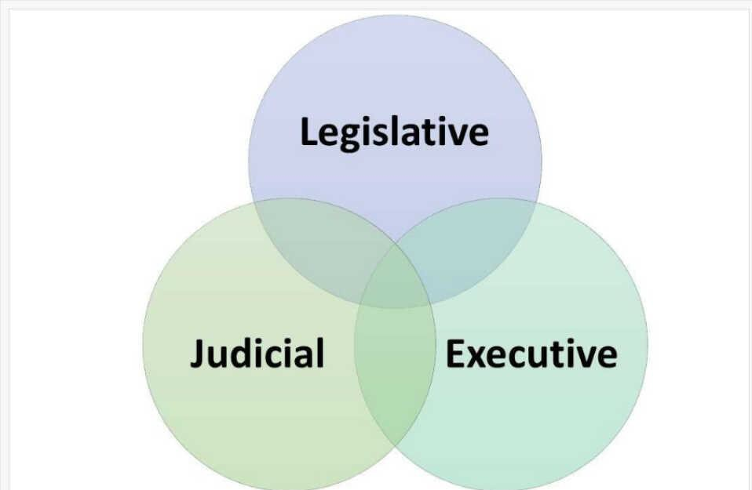
Branches of Government

Slide 3

Legislation: Title IX
No person in the United States shall,
on the basis of sex,
be excluded from participation
in,
be denied the benefits of,
or be subjected to discrimination under any education program
or activity receiving Federal
financial assistance.

Slide 4
Administrative: Title IX Regulations
1975 regulations
1980 OCR tasked with implementing the regulations
1997 OCR policy guidance
2001 OCR reaffirmed obligations of schools to protect against sexual harassment
2003-2010 OCR offers additional and more targeted guidance related to sexual assault.
2011 DCL emphasized schools’ obligations to address sexual harassment and sexual violence
against students
2014 OCR Q & A further clarified schools’ obligations & DOE issued final regulations on
implementation of Campus SaVE Act, amending the Clery Act regulations.
2017 OCR withdrew 2011 DCL and 2014 Q&A
2018 NPRM
2020 Regulations
2022 NPRM
2024 Regulations

Slide 5

Judicial: Injunctions
Tenn., et. al. v. US Dept. of Educ. (July 15, 2022) – Enjoined DOE and EEOC from implementation of guidance providing disparate treatment protections for individuals based on gender identity and sexual orientation. (Alabama, Alaska, Arizona, Arkansas, Georgia, Idaho, Indiana, Kansas, Kentucky, Louisiana, Mississippi, Missouri, Montana, Nebraska, Ohio, Oklahoma, South Carolina, South Dakota, and West Virginia)
Texas v. Cardona (June 11, 2024) – Enjoined DOE 2021 guidance on TIX protections on basis of sexual orientation and gender identity. (Texas)

Slide 6
Judicial: Full Injunctions
State of Louisiana, et.al., v. US Dept. of Educ. (U.S. Dist. Ct. WD Louisiana, June 13, 2024)
Plaintiff States: Louisiana, Mississippi, Montana, Idaho
Tennessee, et. al., v. Cardona (U.S. Dist. Ct. E. Dist. Kentucky Northern Div., June 17, 2024)
Plaintiff states: Tennessee, Kentucky, Ohio, Indiana, Virginia, West Virginia
Kansas, et. al. v. U.S. Dept. of Educ. (U.S. Dist. Ct. Kansas, July 2, 2024)
Plaintiff states: Kansas, Alaska, Utah, Wyoming

Slide 7
Title IX in 2024
Notes:
Note, 2024 TIX regulations were rescinded in January, 2025

Slide 8
When Does Title IX Apply?
Program or Activity Receiving Federal Financial Assistance
§ 106.2 Definitions: Federal Financial Assistance
Grants, loans, scholarships, provision of services of Federal personnel, use of Federal property, contract for provision of assistance by Federal government
Applies across institution if any part of the institution receives Federal funds
Exemptions
Religious
Applies even if other laws also apply
Title VII
State Laws

Slide 9
What is the scope of the application of Title IX?
“. . . be excluded from participation in, be denied the benefits of, or be subjected to discrimination under any education program or activity”

Slide 10
What is the scope of our education program and activities?
In the United States
Off Campus
Student Organizations
On Campus

Slide 11
Factors for whether conduct is within
scope of school’s program or activities
Disparate Treatment Exemptions
TIX Sex-Based Harassment
Membership practices of social fraternities, sororities, or voluntary youth organizations
Maintenance of single sex living facilities
§ 106.11 expressly requires schools to address a hostile environment under its education program or activity, even when some conduct alleged to be contributing to the hostile environment occurred outside the school’s education program or activity or outside the United States.

Slide 12
Factors for whether conduct is within
scope of school’s program or activities
2020 Regs
Building owned or controlled by recognized student organization
A teacher’s sexual harassment
of a student is likely to constitute sexual harassment.
Substantial control over both respondent and context
2024 Regs
Building owned or controlled by
a recognized student organization
Conduct subject to school’s
disciplinary authority
Even when some conduct
contributing to hostile
environment is alleged to have
occurred outside school’s
education program or activity or outside U.S.
Notes:
Note, 2024 TIX regulations were rescinded in January, 2025

Slide 13
Factors for whether conduct is within
scope of school’s program or activities
Conduct occurring in a building owned or controlled by a student organization that is officially recognized by a post-secondary institution
School exerts oversight over the student organization
School has authority to discipline the student organization
Does not prohibit single sex clubs and activities, social fraternities/sororities, single-sex affinity groups, or single sex dormitories that are otherwise permissible under TIX

Slide 14
of school’s program or activities
Factors for whether conduct is within scope
Look at Student Conduct Codes
If other off campus interactions are covered, must apply to sexual harassment
Look at employment policies and precedent
Conduct subject to a school’s disciplinary authority

Slide 15
Factors for whether conduct is within
scope of school’s program or activities
Perpetrator’s status as a
teacher is relevant
A teacher’s sexual harassment of a student is likely to constitute sexual harassment in the program even if the harassment occurs off campus and outside a school activity
Nexus between out-of-school conduct and the school
Possible future encounters between survivor and alleged perpetrators
Does school have substantial control over the context

Slide 16
Factors for whether conduct is within
scope of school’s program or activities
When evaluating the totality of the circumstances to determine whether a sex-based hostile environment exists
under a recipient’s education
program or activity, consider §
106.2 Hostile Environment Sex-Based Harassment – Factors to be Considered.
Hostile Environment Factors

Slide 17
Conduct Outside United States
No change from 2020 regulations that TIX does not have extraterritorial application. TIX does not apply to sex discrimination that occurs outside of the U.S.
A recipient is not independently obligated to respond to an incident of sex discrimination that occurs in another country.
Must still address sex-based hostile environment in program or activity in U.S., even when some conduct alleged to be contributing to the hostile environment occurred outside the U.S.
Other policies, such as codes of conduct might apply.
Clery Act applies even outside of U.S.
Title VII applies to U.S. citizens working for a U.S. corporation abroad.

Slide 18
On the basis of sex
2020 Regs
Deliberately omitted definition of “sex” or “on the basis of sex.”
2020 commentary to regs acknowledged that
sexual harassment impacted many
demographic groups “based on sex, race and
the intersection of sex and race (as well as
other characteristics such as disability status,
sexual orientation, and gender identity).
Sexual harassment not tolerated against LGBTQ students.
Decline to address discrimination on the basis of gender identity.
2024 Regs
§ 106.10: Discrimination on the basis of sex
includes discrimination on the basis of sex
stereotypes, sex characteristics, pregnancy
and related conditions, sexual orientation, and gender identity.
§ 106.31: In the limited circumstances in which TIX permits different treatment or separation on the basis of sex, recipient must not carry it out in a manner that discriminates on the basis of sex by subjecting a person to more than de minimis harm.
A policy or practice that prevents a person from participating in a program or activity
A policy or practice that prevents a person from participating in a program or activity subjects a person to more than de minimis harm on the basis of sex.
Notes:
Note, 2024 TIX regulations were rescinded in January, 2025

Slide 19
Bostock v. Clayton County (2020)
“…in Title VII, Congress outlawed discrimination in the workplace on the basis of race, color, religion, sex, or national origin. Today, we must decide whether an employer can fire someone simply for being homosexual or transgender. The answer is clear. An employer who fires an individual for being homosexual or transgender fires that person for traits or actions it would not have questions in members of a different sex. Sex plays a necessary and undistinguishable role in the decision, exactly
what Title VII forbids.”

Slide 20
What are procedural definitions that apply to Title IX?
Complainant
Respondent
Student
Student with a disability
Relevant
Consent
Remedies & Disciplinary Sanctions

Slide 21
Definition: Complainant
2020 Regs
An individual who is alleged to be the
victim of conduct that could constitute sexual harassment.
2024 Regs
(1) A student or employee who is
alleged to have been subjected to
conduct that could constitute sex
discrimination under Title IX or this part; or
(2) A person other than a student or
employee who is alleged to have been
subjected to conduct that could
constitute sex discrimination under
Title IX or this part and who was
participating or attempting to
participate in the recipient’s education
program or activity at the time of the
alleged sex discrimination.
Notes:
Note, 2024 TIX regulations were rescinded in January, 2025

Slide 22
Definition: Respondent
2020 Regs
An individual who has been reported to be the perpetrator of conduct that could constitute sexual harassment.
2024 Regs
A person who is alleged to have violated the recipient’s prohibition on sex discrimination.
Notes:
Note, 2024 TIX regulations were rescinded in January, 2025

Slide 23
Definition: Student with a Disability
2020 Regs
No definition
2024 Regs
§ 106.2 A student who is an
individual with a disability as
defined in the Rehabilitation Act of 1973, as amended.
§ 106.8(e) TIX Coordinator may
as appropriate with the
individual or office that recipient
has designated to provide
support to students with
disabilities to determine how to
comply with Section 504 of the Rehabilitation Act.
Notes:
Note, 2024 TIX regulations were rescinded in January, 2025

Slide 24
Definition: Relevant
2020 Regs
No definition
Questions and evidence about
complainant’s sexual predisposition or
prior sexual behavior are not relevant,
unless such questions and evidence are
offered to prove that someone other than
the respondent committed the conduct
alleged or if the questions and evidence
concern specific incidents of the
complainant’s prior sexual behavior with
respect to the respondent and are offered to prove consent.
2024 Regs
§106.2-Related to the allegations of sex
discrimination under investigation as part
of the grievance procedures under
§106.45, and if applicable §106.46.
Questions are relevant when they seek
evidence that may aid in showing whether
the alleged sex discrimination occurred,
and
Evidence is relevant when it may aid a
decisionmaker in determining whether the alleged sex discrimination occurred.
§106.45(b)(7) excludes evidence, even if
relevant (confidential employee, medical
records, prior sexual conduct)
Notes:
Note, 2024 TIX regulations were rescinded in January, 2025

Slide 25
Definition: Consent
2020 Regs
Not required to adopt a particular definition of consent with respect to sexual assault.
2024 Regs
Not required to adopt a particular definition of consent with respect to sex- based harassment.
Notes:
Note, 2024 TIX regulations were rescinded in January, 2025

Slide 26
Definition: Remedies
2020 Regs
No Definitions
2024 Regs
Remedies: Measures provided, as
appropriate to a complainant or any other
person the recipient identifies as having
had their equal access to the recipient’s
education program or activity limited or
denied by sex discrimination. These are
provided to restore or preserve access to
the recipient’s education program or
activity after a recipient has determined that sex discrimination has occurred.
Disciplinary Sanctions: Consequences
imposed on a respondent following a
determination that respondent violated
TIX prohibition on sex discrimination.
Notes:
Note, 2024 TIX regulations were rescinded in January, 2025

Slide 27
Definitions: Supportive Measures
2020 Regs
Non-disciplinary, non-punitive
Individualized
Without fee or charge
No unreasonable burden to other party
Restore or preserve equal access to program or activity
Provide at any point during process
2024 Regs
Non-disciplinary, non-punitive
Individualized
Without fee or charge
No unreasonable burden to other party
Restore or preserve equal access to program or activity
Provide at any point during process
Notes:
Note, 2024 TIX regulations were rescinded in January, 2025

Slide 28
Role of the Title IX Coordinator
Designate at least one employee with ultimate oversight to coordinate efforts to comply with TIX requirements
Adopt, disseminate, provide notice, implement non- discrimination policy and procedures
Easy-to-Find contact information for reporting
Prominent, wide-spread, effective and comprehensive
Coordinate training requirements
Record keeping

Slide 29
Policy Revisions
Include what applicable regulations require.
Are they serving the purpose intended?
For students, employees, other participants
For investigators, hearing panels
What might be better communicated outside the policy?
Find the right balance between consistency and discretion.

Slide 30
Credits Slide
NACUA materials, PowerPoint slides and recordings available as part of this program are offered as educational materials for higher education lawyers and administrators. They are prepared by presenters and are not reviewed for legal content by NACUA. They express the legal opinions and interpretations of the authors.
Answers to legal questions often depend on specific facts, and state and local laws, as well as institutional policies and practices. The materials, PowerPoint slides and comments of the presenters should not be used as legal advice. Any hypothetical scenarios presented are based on fictional facts and persons. Any hypothetical scenarios presented are based on fictional facts and persons. Legal questions should be directed to institutional legal counsel.
Those wishing to re-use the materials, PowerPoint slides or recordings
should contact NACUA (nacua@nacua.org) prior to any re-use.

