Slide 1

University of Maine System
2022 Title IX Advisor Training
Kai McGintee, Esq

Slide 2
Training Overview
Title IX Overview & UMS Policy
Title IX Process & Advisor Role
Hearing Structure & Basics
Preparing for Hearing & Cross-Examination
Relevance
What if a Party/Witness Does Not Submit to Cross-Examination?
Decorum
After the Hearing: Written Determinations and Appeals

Slide 3
Applicable Policies
Section 402: Sex Discrimination, Sexual Harassment, Sexual Assault, Relationship Violence, Stalking and Retaliation and Title IX Sexual Harassment
a. UMS Procedures for Title IX Sexual Harassment

Slide 4
What is an Advisor?
UMS Procedures for Title IX Sexual Harassment: “Advisor means a person chosen by a party or appointed by the institution to accompany the party to meetings related to the complaint process, to advise the party on that process, and to conduct cross-examination for the party at the hearing, if any.”
Under the 2020 Title IX regulations, each direct party is entitled to an
advisor of choice. Advisors can be:
A parent
An attorney
A school-assigned official
Any other individual the party chooses
Advisors provide support throughout the formal Title IX process.
One of the most significant roles of a Title IX advisor is to conduct cross-examination on behalf of the party during the hearing process.
Advisors must comply with University policy and guidelines, including
rules of decorum.

Slide 5
Structure of Formal Title IX Process
Grievance Process Begins (Where an advisor’s role can begin)
Incident Reported
Investigation Conducted
Pre-Hearing Preparation
Written Determina tion
Hearing
Appeal

Slide 6
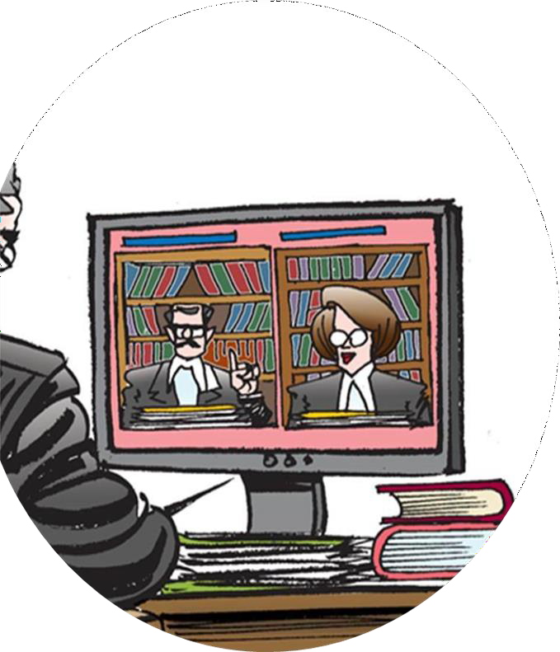
Hearing Requirement
6) Hearings.
(i) For postsecondary institutions, the recipient’s grievance process must provide for a live hearing. At the live hearing, the decision-maker(s) must permit each party’s advisor to ask the other party and any witnesses all relevant questions and follow-up questions, including those challenging credibility.

Slide 7
UMS Hearing Basics
Hearing will be composed of a single Decision-maker or a panel of three Decision-makers at the discretion of the UMS Title IX Coordinator or Equal Opportunity Officer.
If hearing is composed of three Decision-makers, one of them will be designated as voting chair.
Pre-hearing meetings: the Decision-maker or Chair will reach out to both parties and their Advisors for separate pre-hearing meetings.
All UMS hearings are conducted live via Zoom and recorded by UMS.
During the hearing, parties must be able to simultaneously see and hear the party or the witness answering questions.

Slide 8
UMS Hearing Basics Continued
Preponderance of the evidence standard: During the hearing, the burden is on the University to show that it is more likely than not that the Respondent engaged in behavior that violated University policy.
Preparation: All evidence gained over the course of the investigation (investigation report/attachments and evidence record) is provided to the parties, their advisors, and the decisionmaker prior to the hearing. Parties and their advisors can utilize this evidence during the hearing.
Parties and their advisors can request that “directly related” evidence, not deemed relevant by investigator, be considered by decisionmaker. Decisionmaker will rule on relevance/inclusion of this evidence.
Witnesses: parties can make requests for any witness to appear that they think is relevant.
8

Slide 9
Sample Structure of a Hearing …
Event | Time started | Length | Time Finished | Notes
Preliminary matters | - | 15 minutes | - | -
Adjudicator Opening | - | 15 minutes | - | -
Complainant Opening | - | 15 minutes | - | -
Respondent Opening | - | 15 minutes | - | -
Break | - | - | - | -
Investigator statement + Questions | - | 45 minutes | - | -
Complainant Questions | - | 1 hour | - | -
Respondent Questions | - | 1 hour | - | -
Individual Witness Questions | - | 1 hour | - | -
Complainant Close | - | 30 minutes | - | -
Respondent Close | - | 30 minutes | - | -

Slide 10
Cross- Examination Requirement
“Such cross-examination at the live hearing must be conducted directly, orally, and in real time by the party’s advisor of choice and never by a party personally, notwithstanding the discretion of the recipient under paragraph (b)(5)(iv) of this section to otherwise restrict the extent to which advisors may participate in the proceedings. At the request of either party, the recipient must provide for the live hearing to occur with the parties located in separate rooms with technology enabling the decision-maker(s) and parties to simultaneously see and hear the party or the witness answering questions.”
REMEMBER: The goal of cross-examination is not to recite every fact obtained over the course of the investigation, but instead to direct the decision-maker(s) to the specific evidence that supports your advisee’s position.

Slide 11
Advisor Role in Cross-Examination
“If a party does not have an advisor present at the live hearing, the recipient must provide without fee or charge to that party, an advisor of the recipient’s choice, who may be, but is not required to be, an attorney, to conduct cross-examination on behalf of that party.”

Slide 12


Deciding if a Question is Relevant
“Before a complainant, respondent, or witness answers a cross-examination or other question, the decision-maker(s) must first determine whether the question is relevant and explain any decision to exclude a question as not relevant.”

Slide 13

Do I need to brush up on the Federal Rules of Evidence to be prepared for hearings? NO
“The Federal Rules of Evidence constitute a complex, comprehensive set of evidentiary rules and exceptions designed to be applied by judges and lawyers, while Title IX grievance processes are not court trials and are expected to be overseen by layperson officials of a school, college, or university rather than by a judge or lawyer (p.981)”

Slide 14



Types of Evidence at Hearing
Direct evidence
Corroborating evidence
Circumstantial evidence

Slide 15

General Hearing Preparation
Review the investigation report and supporting evidence.
During review of the investigation report, determine if there is any missing information or any witnesses that still need to be
interviewed…this is the last opportunity to put forward witnesses before the hearing.
Create a digest!
Create a timeline

Slide 16

No Surprise Witnesses!
If a Witness has not been shared with Investigator(s) or the Witness refused to be interviewed by the Investigators(s), the Witness cannot appear at the hearing to answer questions.

Slide 17
Preparing Cross-Examination Questions
Brainstorm questions that you would like to ask the parties and
all witnesses that will be present at the hearing.
Meet with your advisee to review questions that they want to be posed to other party/witnesses.
Basic structure of cross-examination:
Obtain any relevant and helpful information from the party
If party does not have helpful information then limit their
significance
Examine possibility of bias

Slide 18
Credibility
Credibility of your advisee and their supporting witnesses is crucial to the
decision-maker(s) making a determination in your advisee’s favor.
As part of hearing preparation, review advisee’s recollection of events, supporting evidence, and arguments.
Are they prepared to answer likely lines of questioning?
Identify gaps in opposing party’s witness’ recollection and supporting evidence.
When opposing party or opposing party’s witness provides information during the hearing and you believe a credibility issue exists …
Confirm: when you identify a credibility issue, ask the party to reiterate their prior statement.
Compare: the party’s testimony to prior statements provided by the party
or prior evidence provided by the party.
3. Confront: ask questions that confront the inconsistencies.
18

Slide 19
Preparing Your Advisee for the Hearing
Review basic structure of hearing
Help them develop opening and closing statements
Work with party to review and develop questions for opposing party and witnesses
Prepare your advisee to be questioned
Ask party if there is any additional information that they think it is important for you to have (party dynamics, etc.)
• Comfort plan
19

Slide 20


What to bring to the hearing
IR, appendix, and any other relevant/corroborating evidence
All the notes you have compiled, including digests. Timeline of events
Hearing schedule
Copies of all relevant University policies Note taking supplies

Slide 21

Only RELEVANT cross examination and other questions may be asked of a party or witness
Excluded:
Non-relevant lines of questioning
Evidence about a Complainant’s prior sexual behavior unless exception is met
Any party’s medical, psychological, and similar records (unless the party has given voluntary, written consent)
Redundant questions

Slide 22
Prior Sexual Behavior
“Questions and evidence about the complainant’s sexual predisposition or prior sexual behavior are not relevant, unless such questions and evidence about the complainant’s prior sexual behavior are offered to prove that someone other than the respondent committed the conduct alleged by the complainant, or if the questions and evidence concern specific incidents of the complainant’s prior sexual behavior with respect to the respondent and are offered to prove consent (p.1592)”

Slide 23
What about prejudicial versus probative?
“A recipient may not adopt evidentiary rules of admissibility that contravene those evidentiary requirements prescribed under § 106.45. For example, a recipient may not adopt a rule excluding relevant evidence whose probative value is substantially outweighed by the danger of unfair prejudice; although such a rule is part of the Federal Rules of Evidence… (p. 981).”

Slide 24

Absence of Parties and Witnesses
“If a party or witness is not present at the hearing or does not answer any or all cross-examination or other questions at the hearing, the decision-maker(s) cannot draw an inference about the determination regarding responsibility based solely on a party’s or witness’ absence from the hearing or refusal to answer any or all cross-examination or other question(s). The University may still proceed with the live hearing in the absence of a party, and may reach a determination of responsibility in their absence, including through any evidence gathered.”
If party chooses not to attend the hearing, their advisor must attend to cross- examine the other party.
If a party’s advisor does not attend the hearing, UMS reserves the right to provide a free advisor of its choice to the party, so the advisor may cross-examine the other party and/or any witnesses.

Slide 25
What protections are available for parties or witnesses who refuse to be cross-examined?
Prohibition against retaliation
The decision-maker(s) may not draw any negative inferences from the absence of one or both parties’ attendance of the hearing.
If a party or the party’s advisor choose not to cross-examine a party or witness, the party shall affirmatively waive cross-examination through a written or oral statement to the decision-maker(s).
A party’s waiver of cross examination does not eliminate the ability of the Chair or Decision-maker(s) to use prior statements made by the party.

Slide 26
Hearing Decorum
Questions must be conveyed in a neutral tone.
Parties and advisors will refer to others using correct pronouns and names.
No party may act abusively or disrespectfully during the hearing toward any other person.
Attorneys must conduct themselves in accordance with the educational purpose of the process and remember they are not in a courtroom.
Advisor may not yell, scream, pound the table, badger, or physically ‘‘lean in’’ to
other’s space.
Advisor may not use profanity or make irrelevant ad hominem attacks upon party/witness.
Questions are meant to be interrogative statements used to test knowledge or understand a fact; they may not include accusations within the text of the question.
The advisor may not ask repetitive or irrelevant questions.
Parties and advisors may take no action at the hearing that a reasonable person in the shoes of the affected party would view as intended to intimidate that person (whether party, witness, or official) into not participating in the process or meaningfully modifying their participation in the process.

Slide 27

Decorum Requirements
Advisors must conduct themselves in a
respectful manner during the hearing.
Advisors may not ask questions in an aggressive, intimidating or threatening manner
Advisors must respect the decision of the Hearing Officer regarding relevancy
The Hearing Officer maintains the ability to ask the Advisor to leave the hearing if they refuse to cooperate with decorum requirements.

Slide 28
Written determination basics
UMS Policy requires the decision-maker(s) to issue a written determination regarding responsibility within 15 business days of the hearing.
Written determination sent to the parties simultaneously.
Written determination MUST include:
Identification of allegations that potentially violate university policy.
Description of procedural history
Findings of fact supporting final determination.
Conclusion regarding the application of university policy to the facts.
A statement of, and rationale for, the result as to each allegation, including a determination regarding responsibility, any disciplinary sanctions the UMS imposes on the Respondent, and any remedies that will be provided to the Complainant.
Procedural and permissible bases for the Complainant and Respondent to appeal.
If Respondent is found responsible for a violation, the decision maker will consider any
previous disciplinary action involving the Respondent when determining sanctions.

Slide 29
Appeals
Complainant or Respondent can file an appeal of a written
determination on the following bases:
Procedural irregularity that affected the outcome of the matter.
New evidence that was not reasonably available at the time of
the determination, that could affect the outcome of the matter.
TIXC, investigator(s), or decision-maker(s) had a conflict of interest or demonstrated bias for or against one of the parties or complainants/ respondents generally, that affected the outcome of the matter.
Parties have five days to file appeal with TIXC, Deputy TIXC, or Equal Opportunity Officer.
If an appeal is not filed within the designated timeline, the
written determination becomes final.

Slide 30
Questions...
Kai McGintee
Bernstein Shur, Shareholder kmcgintee@bernsteinshur.com
(207) 288-7116

