Slide 1
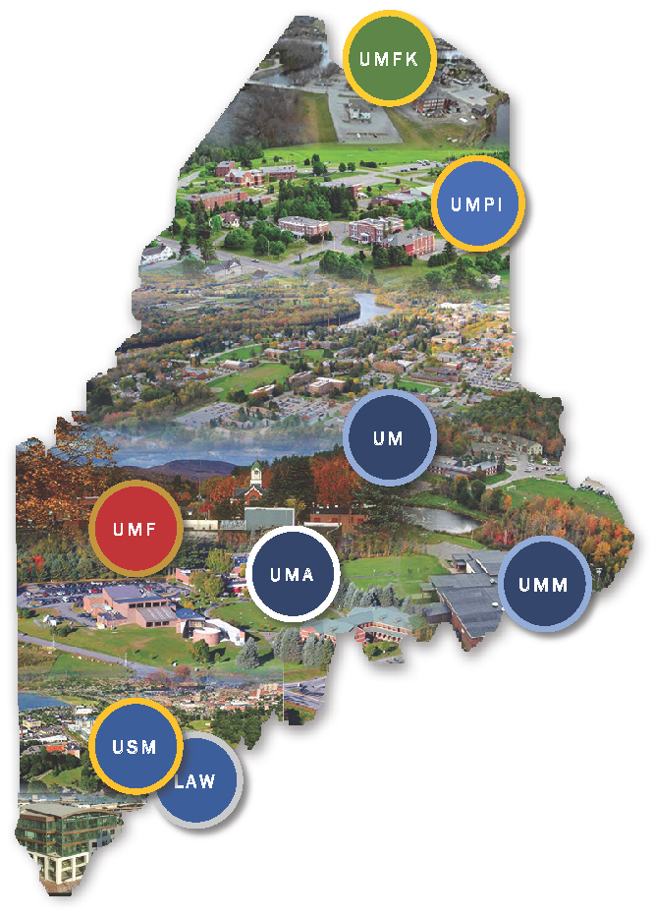
FY24 Annual Report on Gifts, Fundraising and Endowments
UNIVERSITY OF MAINE SYSTEM
ANNUAL REPORT ON GIFTS, FUNDRAISING AND ENDOWMENTS
Year Ended June 30, 2024

Slide 2
Part I: University of Maine System
(Excludes Fund Raising Organizations)

Slide 3
UMS Gifts Received* by Donor Type
($ in millions)
The UMS receives gifts through two methods:
Direct donations from alumni, individuals, corporations, and non-profits
Endowment distributions and non-endowed gifts from its affiliated fund raising organizations, the largest of which are the university foundations (see page 10 for FY23 and FY24 gifts that the affiliates received)
*UMS gifts reported herein include cash, checks and negotiable securities, and pledge payments. Gifts-in-kind and pledges receivable are not included in these totals.

Slide 4
UMS Gifts Received by Restriction Type
($ in millions)
The $10.4 million increase in total gifts from FY23 to FY24 is primarily attributable to an increase in restricted gifts received for construction of the University of Southern Maine’s Center for the Arts.

Slide 5
UMS FY24 Gifts Received by Purpose
($ in millions)
99% of gifts received in FY24 were restricted by the donor for a particular purpose
40% of total FY24 gifts were restricted for facilities
25% of total FY24 gifts were restricted for student aid

Slide 6
UMS Gifts Received by Campus
($ in millions)

Slide 7
UMS Gift Balances as of June 30th
($ in millions)

Slide 8
UMS Gift Balances by Campus as of June 30, 2024
($ in millions)

Slide 9
Part II: UMS Affiliated
Fund Raising Organizations

Slide 10
Gifts Received by UMS Affiliated Organizations
($ in thousands)
57% of FY23 gifts and 46% of FY24 gifts were from Alumni
6% of FY23 gifts and 7% of FY24 gifts were from Alumni

Slide 11
Endowment Market Values for UMS Affiliated Organizations
($ in millions)

Slide 12
Part III: Capital Campaigns

Slide 13
Status of Capital Campaigns as of June 30, 2024
UM Comprehensive Campaign
UM is currently in the planning stage of their next capital campaign. Once the campaign goals are established, they will be presented to the Board of Trustees for approval. Since the June 30, 2020 end date of the last capital campaign, UM and its affiliates have raised $215.7 million of which $26.4 million is in the form of outstanding pledges.

