Slide 1
FY22 Operating Budget
Board of Trustees – June 25, 2021

Slide 2
Unified Budget Timeline

Slide 3
FY22 Budget Pressures & COVID19
Federal funding being used in FY21 and FY22 to cover COVID related expenses and / or lost revenue
Although increased above FY21 levels, residence hall occupancy rates remain below full capacity, contributing to auxiliary budget challenges
Gordian (Sightlines) data continues to show declines in campus NAV and increases in renovation age across UMS facilities; and
Received $14.9M in Coronavirus Relief Funds from State of Maine to partially offset testing, PPE, and quarantine costs

Slide 4
FY22 Budget Overview
Enrollment
Enrollment budgeting process focuses on returning students and realistic enrollment goals adjusted for potential COVID19 impact.
FY22 budgeted credit hours are 1.5% above FY21 budget and 0.6% above FY21 actuals.
Appropriation - 3% increase plus $1.5M for Maine Law
In-state tuition – no increase
Capital investments - $4.5M increase (20%) over FY21 budget
Budget Balancing
UMA, UMFK, UMPI, and USM will utilize CARES funds to offset their budgeted operating losses in FY22. UMF is utilizing CARES funds and requesting the utilization of previously approved Budget Stabilization Funds to balance the budget.
Maine Law has minimal CARES funds and no reserves; requesting Budget Stabilization Funds to offset the operating loss.
UM will have exhausted CARES funds and is utilizing reserves to balance the budget.

Slide 5
FY22 Budget Overview – PRIOR (May 5th FFT)
 | E&G | Auxiliary | Total | CARES | Campus Reserves | Budget Stabilization | Total
UMaine | $ 0 | $ 0 | $ 0 | $0 | $ 0 | $ 0 | $ 0
UMA | 465,911 | (451,082) | 14,829 | - | - | - | 14,829
UMF | (3,102,759) | (528,744) | (3,631,503) | 1,707,320 | 145,961 | 1,778,222 | 0
UMFK | (214,407) | (535,593) | (750,000) | 750,000 | - | - | 0
UMPI | (939,053) | (175,945) | (1,114,998) | 1,114,998 | - | - | 0
USM | 365,035 | (365,035) | - | - | - | - | 0
Maine Law | (2,426,386) | - | (2,426,386) | - | - | 2,426,386* | 0
Governance/Univ. Serv. | - | - | - | - | - | - | 0
Total | $(5,851,659) | $ (2,056,399) | $(7,908,058) | $3,572,318 | $ 145,961 | $4,204,608 | $ 14,829
* Proposed new funding

Slide 6
FY22 Budget Overview - Revised
 | E&G | Auxiliary | Total | CARES | Approp | Campus Reserves | Budget Stabilization | Total
UMaine | $ (2,079,042) | $ 0 | $ (2,079,042) | $0 | - 573,387 | $1,505,655 | $ 0 | $ 0
UMA | 66,407 | (451,082) | (384,675) | 384,675 | - | - | - | 0
UMF | (3,452,319) | (528,744) | (3,981,063) | 1,383,118 | 899,837 | 145,961 | 1,552,147 | 0
UMFK | (343,155) | (535,593) | (878,748) | 878,748 | - | - | - | 0
UMPI | (1,015,871) | (223,711) | (1,239,582) | 1,239,582 |  | - | - | 0
USM | (712,213) | (365,035) | (1,077,248) | 1,077,248 | - | - | - | 0
Maine Law | (3,926,386) | - | (3,926,386) | - | 2,000,000 | - | 1,926,386* | 0
Governance/Univ. Serv. | - | - | - | - | - | - | - | 0
Total | $(11,462,579) | $ (2,104,165) | $(13,566,744) | $4,963,371 | $3,473,224 | $ 1,651,616 | $3,478,533 | $ 0
* Proposed new funding

Slide 7
Budget Stabilization Fund
The Budget Stabilization Fund was created to enable the UMS to smooth the financial impact of adverse markets, economic conditions, and address other financial challenges.
The Fund was established in 2010 and has been built from net investment income that exceeded budget pursuant to the Board of Trustees investment policy.
The Treasurer will authorize only the transfer needed to offset a net unrestricted operating loss for each institution at the close of FY21 and FY22.
Balance 7/1/20 $12,114,212
Maine Law direct appropriation increased from $856,808 to $3,281,808 in FY22
Utilization | FY21 (approved) | FY21 (amended) | FY22* (recommended)
Maine Law (incl FY20 cfwd) | (1,961,444) | (1,415,149) | (1,926,386)
UMF | (2,959,661) | 0 | (1,552,147)
Investment gain/loss | TBD | TBD | TBD
Subtotal | ($4,921,105) | ($1,415,149) | ($3,478,533)
Proj Bal (7/1/20 Bal-Amended- Recommended)
*requires BOT approval
$7,220,530

Slide 8
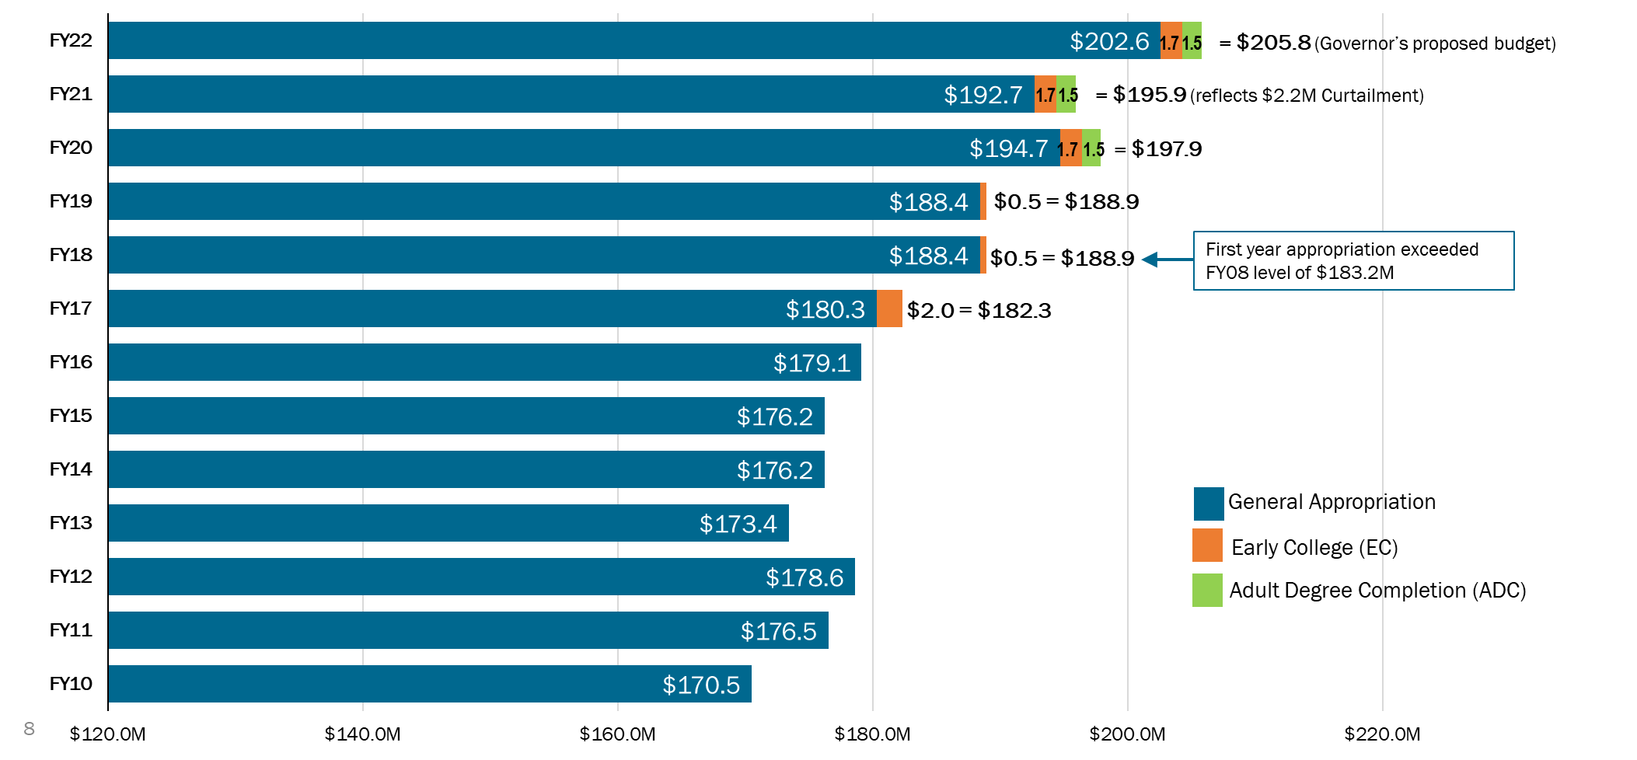
E&G State Appropriation (excl. restricted funds, e.g. MEIF & Debt Service)

Slide 9
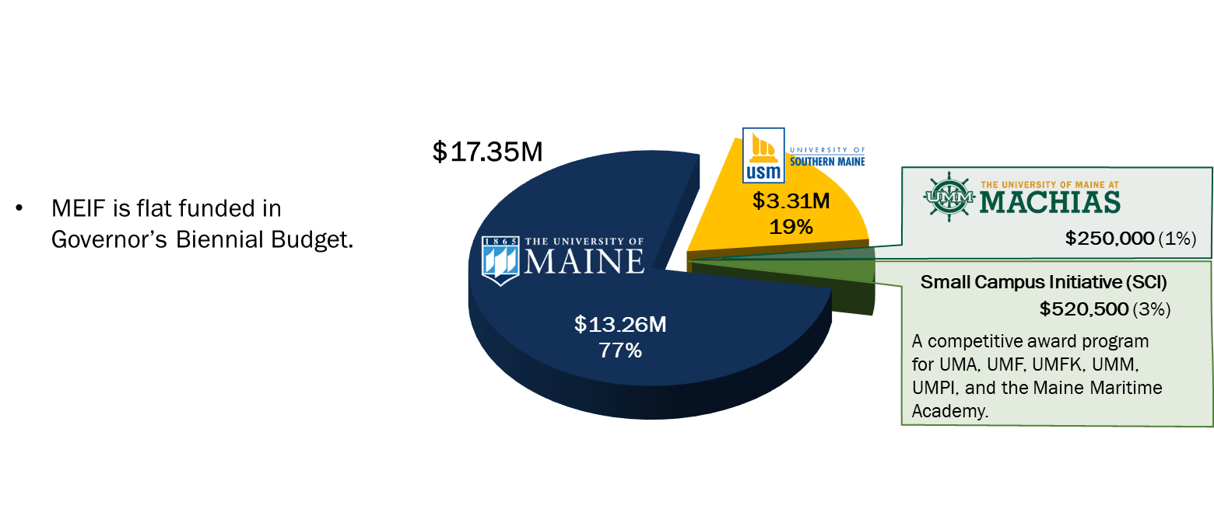
Maine Economic Improvement Fund (MEIF)
 | UMaine | USM | UMM | SCI | Total
Biotechnology | 1,357,411 | 110,180 |  |  | 1,467,591
Aquaculture & Marine | 2,499,453 | 348,563 | 250,000 |  | 3,098,016
Composite Materials | 1,541,320 | 50,000 |  |  | 1,591,320
Environmental | 1,589,518 | 100,000 |  |  | 1,689,518
Forestry & Agriculture | 1,810,262 | 510,760 |  |  | 2,321,022
Information Technology | 1,471,246 | 524,253 |  |  | 1,995,499
Precision Manufacturing | 1,586,896 | 100,000 |  |  | 1,686,896
Cross Sector | 1,407,494 | 1,572,144 |  |  | 2,979,638
Small Campus Initiative |  |  |  | 520,500 | 520,500
Total | 13,263,600 | 3,315,900 | 250,000 | 520,500 | 17,350,000

Slide 10
UMS Enrollment
Major factors impacting enrollment:
Budgeting a modest increase in credit hours above FY21 actuals
Out of state credit hours comprise 25% of total credit hours
FY22 Enrollment Budget
(excludes Early College)
Budget
Actual
Early College
1.5%
above FY21
0.6%
above FY21
(excludes EC)
CBE/AP
CBE
AP/CBE

Slide 11
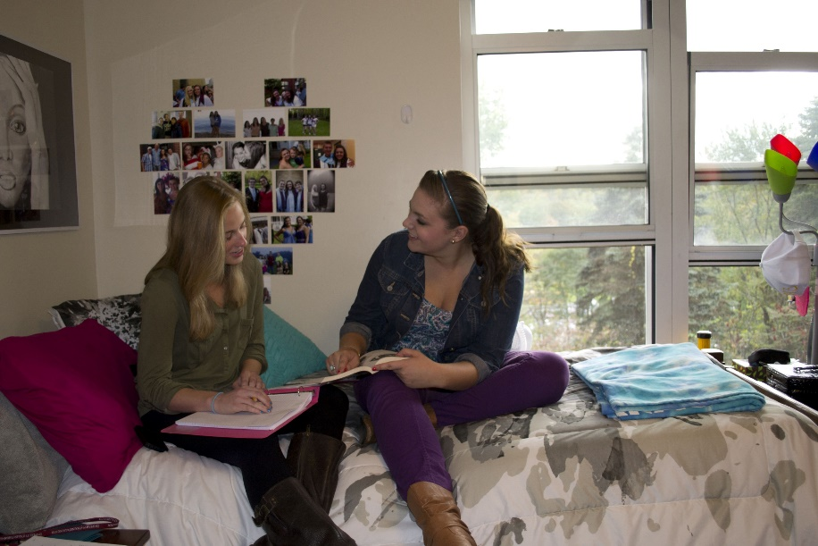
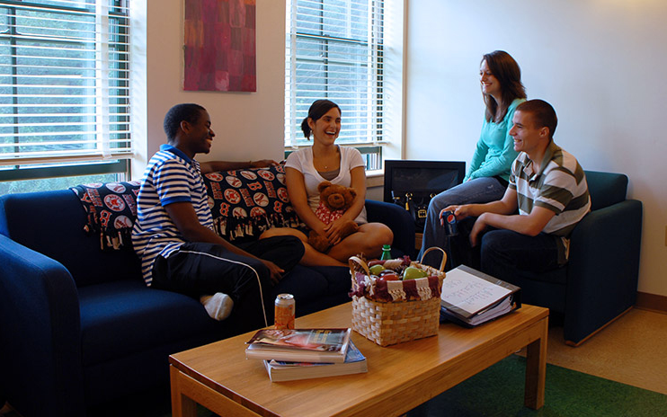
Residence Hall Occupancy (Annual Average)
FY22
Normal Occupancy Rates range from 56% at UMM to 95% at USM.
Based on COVID Capacity, UMA, UMF, & USM occupancy = 100%.
Normal Occupancy | 92% | 91% | 91% | 61% | 81%
COVID Occupancy |  |  |  | 70% | 89%

Slide 12
FY22 Recommended Tuition Rates (Excluding UMaine/UMM)
Undergraduate
Graduate
 | FY21 Rate/CH | FY22 Proposed Rate/CH
In-State/Canadian |  |  | $ | %
UMA/UMFK/UMPI | $245 | $245 | $0 | 0.0%
UMF / USM | $288 | $288 | $0 | 0.0%
Out-of-State
UMA | $592 | $607 | $15 | 2.5%
UMF | $645 | $661 | $16 | 2.5%
UMFK/UMPI | $392 | $392 | $0 | 0.0%
USM | $769 | $788 | $19 | 2.5%
 | FY21 Rate/CH | FY22 Proposed Rate/CH
In-State/Canadian |  |  | $ | %
UMA/USM | $432 | $432 | $0 | 0.0%
UMF | $427 | $427 | $0 | 0.0%
Maine Law | $773 | $773 | $0 | 0.0%
Out-of-State
UMA | $ 540 | $ 554 | $14 | 2.6%
USM | $1,186 | $1,216 | $30 | 2.5%
Maine Law | $1,156 | $1,156 | $0 | 0%
FY22 Proposed Increases
FY22 Proposed Increases

Slide 13
Tuition & Fee Rate Consolidation
UMS Task Force exploring restructuring of tuition & fees and ways of simplifying bills for transparency
UMaine is proposing consolidating some mandatory fees into the FY22 tuition rate as part of a UMS pilot. UMaine’s per credit hour tuition would increase by approximately $80 (UMM by $37) if all but 2 mandatory fees were rolled into a single tuition rate. Excluded fees:
USM is proposing a pilot to simplify its current fee structure. The proposal would consolidate most student fees--including course fees--into a new Comprehensive Fee ($60/CH).
Reviewing the large volume of fees across the system (+500 separate fees).
Public Higher Education trend to collapse most fees into a single tuition rate with a neutral impact on students
Collapsing results in simplifying student bills resulting in more transparency to students & parents
Streamlined billing process results in operational efficiencies and cost savings
Communication & discussion with students, including Student Government, is key to a successful restructuring.
The proposal would provide greater transparency for students and their families into USM's cost of attendance
Proposal would be revenue neutral to the University's FY22 budget
Student Activity Fee -approved by Students
Technology Fee – designated to support campus technology & educational environment

Slide 14
UMaine Tuition / Fee Roll up Impact
UMaine is proposing consolidating some mandatory fees into the FY22 tuition rate as part of a UMS pilot. UMaine’s per credit hour tuition would increase by approximately $80 (UMM by $37) if all but 2 mandatory fees were rolled into a single tuition rate. Excluded fees:
 | FY21 credit hour rate | adj | Rolled up credit hour rate | FY22 credit hour rate | Student/ Technology annual fee | Annual tuition**
Undergraduate
In-State* | $ 308 | $ 80 | $ 388 |  | $ 346 | $ 11,986
Out-of-State | $ 1,001 | $ 80 | $ 1,081 | $ 1,108 | $ 346 | $ 33,586
NEBHE | $ 524 | $ 80 | $ 604 | $ 660 *** | $ 346 | $ 20,146
Graduate
In-State* | $ 461 | $ 80 | $ 541 |  | $ 276 | $ 10,014
Out-of-State | $ 1,503 | $ 80 | $ 1,583 | $ 1,623 | $ 276 | $ 29,490
NEBHE | $ 784 | $ 80 | $ 864 | $ 920 *** | $ 276 | $ 16,836
Student Activity Fee -approved by Students
Technology Fee – designated to support campus technology & educational environment
* includes Canadians
** 30 credits/year for undergrad; 18 credits/year for grad
*** NEBHE rate calculated at 170% of resident

Slide 15
UMaine's Online Proposed Rates
UMaine is proposing consolidating some mandatory fees into the FY22 tuition rate as part of a UMS pilot. UMaine’s per credit hour tuition would increase by approximately $80 (UMM by $37) if all but 2 mandatory fees were rolled into a single tuition rate. Excluded fees:
 | FY21 credit hour rate | adj | Rolled up credit hour rate | FY22 credit hour rate, includes 2.5% increase |  | Tech fee per credit hour | Total per credit hour
Undergraduate
Online - resident | $ 308 | $ 80 | $ 388 | $ |  | $ 7 | $ 395
Online – non-resident (e-rate) | $ 385 | $ 80 | $ 465 | $ 485 | * | $ 7 | $ 492
Graduate Online blended program rates (all inclusive)**
MBA |  |  | $ 610 | $ 650
Engineering |  |  | $ 675 | $ 700
Education |  |  | $ 567 | $ 565
All other |  |  | $ 573 | $ 600
Student Activity Fee -approved by Students
Technology Fee – designated to support campus technology & educational environment
**Proposed maximum online graduate rates for fall 2021

Slide 16
UMM's Tuition/fee roll up impact
 | FY21 credit hour rate | Adj | Rolled up credit hour rate | FY22 credit hour rate, | Tech fee per credit hour | Total per credit hour
Undergraduate
In-State* | $ 245 | $ 37 | $ 282 |  | $ 480 | $ 8,940
Out-of-State | $ 490 | $ 37 | $ 527 | $ 540 | $ 480 | $ 16,680
NEBHE | $ 392 | $ 37 | $ 429 | $ 480 | $ 480 | $ 14,880
*includes Canadians
** 30 credits/year for undergrad
UMM's Online Proposed Rates
 | FY21 credit hour rate | Adj | Rolled up credit hour rate | FY22 credit hour rate, |  | Tech fee per credit hour | Total per credit hour
Undergraduate
Online - resident | $ 245 | $ 37 | $ 282 | $ |  | $ 7 | $ 289
Online – non-resident (e-rate) | $ 490 | $ 37 | $ 527 | $ 352 | * | $ 7 | $ 359

Slide 17
USM Student Fee Proposal
USM’s Comprehensive fee proposal would consolidate:
Unified fee
Transportation fee
Health fee
Online fee
Course fees
Administrative fees
Professional Development fees
Student Activity fee and ad hoc fees (e.g. enrollment and payment fees) would remain.
Undergraduate
In-State, 12 credits
Graduate
In-State, 6 credits
 | FY22 Current | FY22 Proposed
Tuition | $3,540 | $3,540
Unified fee (current) Comprehensive fee ($60/CH – proposed) | $396 | $720
Transportation fee | $110 | --
Student Activity fee | $70 | $70
Health fee | $80 | --
Online course enrollment fee (example) | $120 | --
Summer administrative fee | $35 | --
Course fees (example) | $120 | --
Total Cost | $4,471 | $4,330
 | FY22 Current | FY22 Proposed
Tuition | $2,658 | $2,658
Unified fee (current) Comprehensive fee ($60/CH – proposed) | $198 | $360
Transportation fee | $83 | --
Health fee | $80 | --
Online course enrollment fee (example) | $120 | --
Summer administrative fee | $35 | --
Grad. student prof. dev. fee | $20 | --
Course fees (example) | $50 | --
Total Cost | $3,244 | $3,018

Slide 18
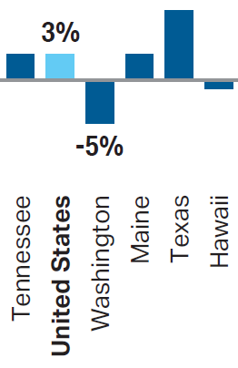
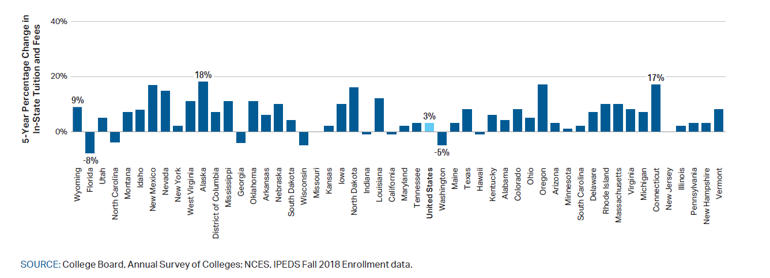
2019-20 Average Annual Tuition Growth Rates
Tuition and Fees by State — Public Four-Year In-State
2%
Adjusted for inflation
Source: College Board, Trends in Pricing and Student Aid 2020
2%

Slide 19
UMS In-State Tuition as a % of Maine Per Capita Income

Slide 20
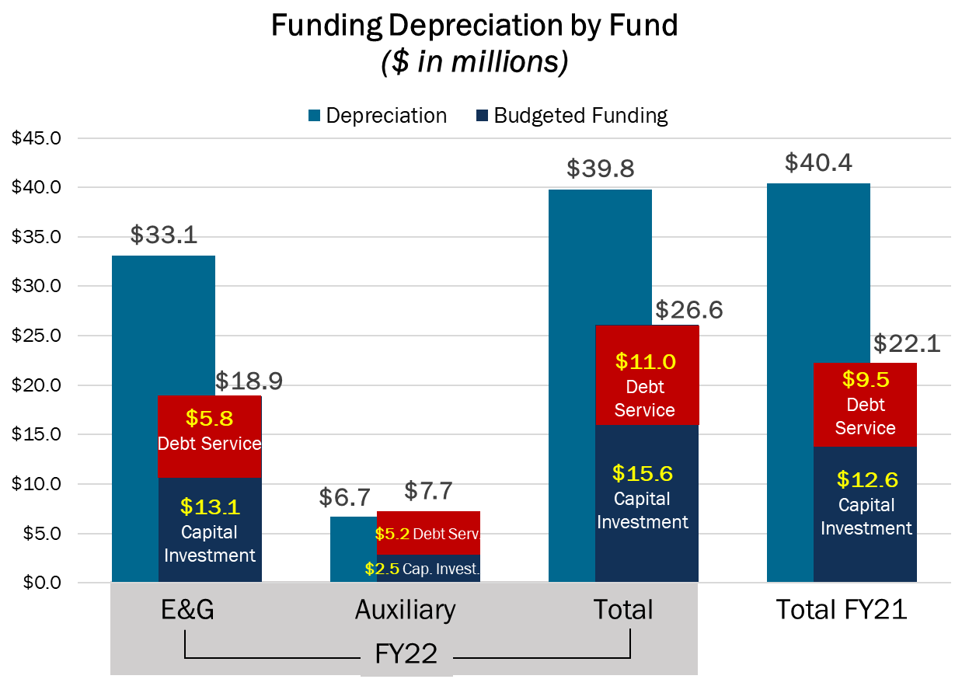
Funding Depreciation
FY22 required capital funding sources – 1) restored curtailment 2) minimum 5% campus increase
Total investment increase is $4.5M or 20%
Depreciation expense decreased by $0.6M - from $40.4M in FY21 to $39.8M in FY22.
E&G and Auxiliary budgeted capital investment = $15.6M; an increase of $3.0M.
Funding through Debt Service increasing by $1.5M.
67% of the total depreciation expense is funded in the FY22 budget – up 12% from the FY21 budget.

Slide 21
Capital Investments from Operations
 | Facilities & Infrastructure | Equipment & Vehicles | Projects to be determined during FY22 | Capital Reserve Deposit (to be utilized in FY23 or after) | TOTAL INVESTMENT
UMAINE/UMM | $ 1,783,064 | $ 1,837,727 | $ 4,212,636 |  | $ 7,833,427
UMA | 907,611 | 34,179 |  |  | 941,790
UMF | 310,650 | 115,000 |  | 467,461 | 893,111
UMFK | 337,842 | - |  |  | 337,842
UMPI | 348,792 |  |  | - | 348,792
USM | 2,776,694 |  |  |  | 2,776,694
UNIV SERV - IT | 1,000,000 | 675,875 |  | 850,000 | 2,525,875
TOTAL | $ 7,464,653 | $ 2,662,781 | $ 4,212,636 | $ 1,317,461 | $ 15,657,531
TOTAL % INVESTMENT

Slide 22
FY22 E&G and Auxiliary Operations – Capital Investments
FY22 Budget
 | PROJECT DESCRIPTION | E&G | AUXILIARY | Total
UMAINE/UMM
Maine special projects | Other | 600,000 | -
Electrical Distribution Upgrades | Utility Infrastructure | 70,000 | -
Alfond Arena FD - Annual Required | Other | 48,500 | -
Memorial Gym FD - Annual Required | Other | 140,000 | -
Classroom P&P projects - Various | Other | 100,000 | -
Annual Funded Depreciation - Various Projects | Other | 3,612,636 | -
Residence Hall bathroom renovation | Renovation | - | 1,424,564
Vehicles | - | 250,000 | 6,350
Equipment |  | 1,209,987 | 371,390
Capital Reserve Funding |  | - | -
TOTAL |  | $ 6,031,123 | $ 1,802,304 | $ 7,833,427
UMA
Handley Hall HVAC updates | Building Systems | 507,320 | $ -
Katz Library HVAC Repairs | Building Systems | 250,291 | -
Bangor Campus Walkways | Grounds Infrastructure | 100,000 | -
Landscaping Design Work | Grounds Infrastructure | 50,000 | -
Equipment |  | 34,179 | -
TOTAL |  | $ 941,790 | $ - | $ 941,790

Slide 23
FY22 E&G and Auxiliary Operations – Capital Investments (cont.)
FY22 Budget
 | PROJECT DESCRIPTION | E&G | AUXILIARY | Total
UMF
Window Replacement - Franklin Hall | Building Systems | 70,000 | -
Roof Replacement - Ricker Hall | Building Envelope | 107,000 | -
Roof Replacement - Scoot Hall | Building Envelope | - | 133,650
Equipment |  | - | 115,000
Capital Reserve Funding |  | 356,653 | 110,808
TOTAL |  | $ 533,653 | $ 359,458 | $ 893,111
UMFK
Gymnasium Renovation | Renovation | 337,842 | -
TOTAL |  | $ 337,842 | $ - | $ 337,842
UMPI
Paving Upgrades | Grounds Infrastructure | 75,000 | -
Campus Center Boiler Replacement | Building Systems | 100,000 | -
Building Automation | Building Systems | 38,272 | -
Campus Access Control - Multiple | Safety / Code | 25,000 | -
Campus Access Control | Safety / Code | - | 25,520
Merriman Kitchen and Lobby Renovation | Renovation | - | 40,000
Building Automation-Multiple | Building Systems | - | 45,000
TOTAL |  | $ 238,272 | $ 110,520 | $ 348,792

Slide 24
FY22 E&G and Auxiliary Operations – Capital Investments (cont)
 | PROJECT DESCRIPTION | E&G | AUXILIARY | TOTAL
USM
Glickman Boiler Replacement | Building Systems | 30,000 | -
Science Boiler Replacement | Building Systems | 30,000 | -
Russell Hall Envelope Repair | Building Envelope | 114,364 | -
Portland Underground Util Rep | Utility Infrastructure | 585,000 | -
IT Option 6 | Utility Infrastructure | 420,000 | -
Gorham Underground Util Rep | Utility Infrastructure | 50,000 | -
Portland Underground Util Rep | Utility Infrastructure | 50,000
Construction of Grounds Garage Maintenance Garage/Salt Shed | New Space | 215,000
Portland Underground Util Rep | Utility Infrastructure | 1,000,000 | -
Robie Andrews Bathroom Upgrades | Building Systems | - | 282,330
Equipment |  | - | -
TOTAL |  | $ 2,494,364 | $ 282,330 | $ 2,776,694
UNIVERSITY SERVICES
A/R Billing System Replacement | Infrastructure | 150,000 | -
IP Telephone Conversion | Infrastructure | 533,500 | -
Orono Switchroom Power Distribution | Infrastructure | 100,000 | -
Orono Switchroom Battery Replacement | Infrastructure | 80,000 | -
MaineStreet Interface Enhancements | Infrastructure | 136,500 | -
Various Equipment Refreshes | Equipment | 675,875
Capital Reserve | Capital Reserve | 850,000
TOTAL |  | $ 2,525,875 | $ - | $ 2,525,875
GRAND TOTAL |  | $ 13,102,919 | $ 2,554,612 | $ 15,657,531
Implementation of IT capital projects (excluding equipment) pending return on investment income

Slide 25
FY22 Proposed Budget: E&G
 |  | FY21 Base | FY22 Base | $ Change | % Change
Revenue: | Tuition & Fees | $ 321,379,167 | $ 327,992,686 | $ 6,613,519 | 2.1%
 | Tuition Waivers/Scholarships | (92,599,588) | (90,660,676) | 1,938,912 | -2.1%
 | State Appropriation | 195,862,398 | 205,804,730 | 9,942,332 | 5.1%
 | Sales/Services/Other | 37,887,432 | 40,872,579 | 2,985,147 | 7.9%
 | Total Revenue | 462,529,409 | 484,009,319 | 21,479,910 | 4.6%
Expense: | Personnel (net of $9.3M attrition) | 356,743,769 | 363,689,305 | 6,945,536 | 1.9%
 | Fuel & Electricity | 15,122,044 | 15,351,701 | 229,657 | 1.5%
 | Supplies & Services | 32,000,486 | 34,840,232 | 2,839,746 | 8.9%
 | Travel | 4,667,675 | 5,018,754 | 351,079 | 7.5%
 | Memberships, Contributions & Sponsorships | 1,123,242 | 1,127,769 | 4,527 | 0.4%
 | Maintenance & Alterations | 11,935,435 | 11,995,428 | 59,993 | 0.5%
 | Interest Expense | 1,390,267 | 1,239,891 | (150,376) | -10.8%
 | Depreciation | 33,945,343 | 33,148,096 | (797,247) | -2.3%
 | Other Expenses & Transfers | 28,059,779 | 39,859,115 | 11,799,336 | 42.0%
 | Total Operating Expenses & Transfers | 484,988,040 | 506,270,291 | 21,282,251 | 4.4%
 | Operating Increase (Decrease) | $ (22,458,631) | $ (22,260,972) | $ 197,659 | -0.9%
Modified | Add back Depreciation | 33,945,343 | 33,148,096 | (797,247) | -2.3%
Cash Flow: | Less Capital Expenditures | (8,455,934) | (11,746,266) | (3,290,332) | 38.9%
 | Less Capital Reserve Funding | (3,249,979) | (1,356,653) | 1,893,326 | -58.3%
 | Less Debt Service Principal | (4,252,774) | (5,773,560) | (1,520,786) | 35.8%
 | Net Change Before Other Adj & Transfers | (4,471,975) | (7,989,355) | (3,517,380)
 | Transfer from/(to) Budget Stabilization | 4,277,470 | 3,478,533 | (798,937)
 | Net Change Subtotal | (194,505) | (4,510,822) | (4,316,317)
 | Other Strategic Transfers from/(to) Reserves | 6,116,261 | 1,651,616 | (4,464,645)
 | Net Change in Cash & Reserve Transfers | $ 5,921,756 | $ (2,859,206) | $ (8,780,962)
 | Net Change after CARES |  | $ 0
Sales/Services/Other
State Appropriation
Net Tuition & Fee Revenue
Non-Compensation
Compensation

Slide 26
FY22 Proposed Budget: Auxiliary
 |  | FY21 Base | FY22 Base | $ Change | % Change
Revenue: | Tuition & Fees | $ 173,175 | $ 873,175 | $ 700,000 | 404.2%
 | Dining | 22,303,302 | 28,925,528 | 6,622,226 | 29.7%
 | Residence | 25,922,961 | 33,159,977 | 7,237,016 | 27.9%
 | Tuition Waivers/Scholarships | (2,482,475) | (2,461,735) | 20,740 | -0.8%
 | Sales/Services/Other | 13,664,146 | 10,503,376 | (3,160,770) | -23.1%
 | Total Revenue | 59,581,109 | 71,000,321 | 11,419,212 | 19.2%
Expense: | Personnel Expense | 23,214,007 | 23,698,937 | 484,930 | 2.1%
 | Fuel & Electricity | 5,500,894 | 5,628,025 | 127,131 | 2.3%
 | Supplies & Services | 18,092,382 | 20,545,284 | 2,452,902 | 13.6%
 | Travel | 84,211 | 76,359 | (7,852) | -9.3%
 | Memberships, Contributions & Sponsorships | 18,957 | 18,876 | (81) | -0.4%
 | Maintenance & Alterations | 4,005,603 | 4,058,898 | 53,295 | 1.3%
 | Interest Expense | 3,194,793 | 2,994,438 | (200,355) | -6.3%
 | Depreciation | 6,434,198 | 6,655,351 | 221,153 | 3.4%
 | Other Expenses & Transfers | 11,174,430 | 8,314,913 | (2,859,517) | -25.7%
 | Total Operating Expenses & Transfers | 71,719,475 | 71,991,081 | 271,606 | 0.4%
 | Operating Increase (Decrease) | $ (12,138,366) | $ (990,760) | $ 11,147,606 | -91.8%
Modified | Add back Depreciation | 6,434,198 | 6,655,351 | 221,153 | 3.4%
Cash Flow: | Less Capital Expenditures | (944,587) | (2,443,804) | (1,499,217) | 158.7%
 | Less Capital Reserve Funding | - | (110,808) | (110,808) | -%
 | Less Debt Service Principal | (5,210,461) | (5,214,144) | (3,683) | 0.1%
 | Net Change Before Other Adj & Transfers | (11,859,216) | (2,104,165) | 9,755,051
 | Transfer from/to Budget Stabilization | 643,635 | - | (643,635)
 | Other Strategic Transfers from/(to) Reserves | 5,362,282 | - | (5,362,282)
 | Net Change in Cash & Reserve Transfers | $ (5,853,299) | $ (2,104,165) | $ 3,749,134
 | Net Change after CARES |  | $ 0
Sales/Services/Other
Dining & Residence Revenue
Compensation
Non-Compensation

Slide 27
FY22 Proposed Budget: E&G and Auxiliary
 |  | FY21 Base | FY22 Base | $ Change | % Change
Revenue: | Tuition & Fee | $ 321,552,342 | $ 328,865,861 | $ 7,313,519 | 2.3%
 | Dining | 22,303,302 | 28,925,528 | 6,622,226 | 29.7%
 | Residence | 25,922,961 | 33,159,977 | 7,237,016 | 27.9%
 | Tuition Waivers/Scholarships | (95,082,063) | (93,122,411) | 1,959,652 | -2.1%
 | State Appropriation | 195,862,398 | 205,804,730 | 9,942,332 | 5.1%
 | Sales/Services/Auxiliary | 51,551,578 | 51,375,955 | (175,623) | -0.3%
 | Total Revenue | 522,110,518 | 555,009,640 | 32,899,121 | 6.3%
Expense: | Personnel (net of $9.3M attrition) | 379,957,776 | 387,388,242 | 7,430,466 | 2.0%
 | Fuel & Electricity | 20,622,938 | 20,979,726 | 356,788 | 1.7%
 | Supplies & Services | 50,092,868 | 55,385,516 | 5,292,648 | 10.6%
 | Travel | 4,751,886 | 5,095,113 | 343,227 | 7.2%
 | Memberships, Contributions & Sponsorships | 1,142,199 | 1,146,645 | 4,446 | 0.4%
 | Maintenance & Alterations | 15,941,038 | 16,054,326 | 113,288 | 0.7%
 | Interest Expense | 4,585,060 | 4,234,329 | (350,731) | -7.6%
 | Depreciation | 40,379,541 | 39,803,447 | (576,094) | -1.4%
 | Other Expenses & Transfers: | 39,234,209 | 48,174,028 | 8,939,819 | 22.8%
 | Total Operating Expenses & Transfers | 556,707,515 | 578,261,372 | 21,553,857 | 3.9%
 | Operating Increase (Decrease) | $ (34,596,997) | $ (23,521,732) | $ 11,345,265 | -32.8%
Modified | Add back Depreciation | 40,379,541 | 39,803,447 | (576,094) | -1.4%
Cash Flow: | Less Capital Expenditures | (9,400,521) | (14,190,070) | (4,789,549) | 50.9%
 | Less Capital Reserve Funding | (3,249,979) | (1,467,461) | 1,782,518 | -54.8%
 | Less Debt Service Principal | (9,463,235) | (10,987,704) | (1,524,469) | 16.1%
 | Net Change Before Other Adj & Transfers | (16,331,191) | (10,093,520) | 6,237,671
 | Transfer from/(to) Budget Stabilization | 4,921,105 | 3,478,533 | (1,442,572)
 | Net Change Subtotal | (11,410,086) | (6,614,987) | 4,795,099
 | Transfer from/(to) Admin Savings Rsrv | 11,478,543 | 1,651,616 | (9,826,927)
 | Net Change in Cash & Reserve Transfers | $ 68,457 | $ (4,963,371) | $ (5,031,828)
 | Net Change after CARES |  | $ 0
Sales/Services/Other
State Appropriation
Net Tuition & Fee Revenue
Net Dining & Residence Revenue
Non-Compensation
Compensation

Slide 28
Quasi-Independent State Entities Budget Requirement
Public Law 2011, Chapter 616 mandates:
Board of Trustees approval of the annual budget for travel, meals, and entertainment costs.
Board of Trustees approval of the annual budget for contribution expenses – defined by this Public Law as membership dues & fees, gifts, donations, and sponsorships.
Periodic reporting of the actual travel and contribution costs by the UMS to the Board of Trustees.
Annual reporting to the Legislature by the UMS of contributions made to persons in the preceding year that were greater than $1,000, and the total contributed to each.
FY22 Budget | ($000’s) | ($000’s)
Fund | Travel, Meals, Entertainment | Memberships, Gifts, Donations, & Sponsorships
E&G/Auxiliary | $5,095 | $ 1,147
Restricted/Other | 4,000 | 550
Total | $9,095 | $ 1,697
E&G/Auxiliary are included in the proposed operating budgets. Restricted/Other includes grants & contracts, MEIF, Coop. Ext, etc. and is not included in the operating budgets.
UMS “Use of University funds” policy generally prohibits charitable contributions; Sponsorships which advance the University’s mission are allowed. UMS “Travel & Expense” policy defines what constitutes allowable travel, meals, and entertainment expenses.

