Slide 1
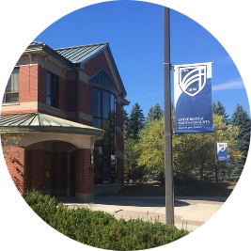
FY21 REVISED Unified Operating Budget
Board of Trustees October 28, 2020

Slide 2
FY21 Budget Pressures & COVID19
For some campuses, FY20 CARES Act funding was insufficient to offset FY20 COVID19-related costs and losses of revenue.
COVID19 impact on state revenues resulted in an appropriation curtailment in FY21 almost $2.3M which has been factored into this budget.
COVID19 guidance regarding social distancing and small groups, combined with the public’s cautious concerns, has resulted in smaller class sizes, and fewer revenue-generating activities on campus (conferences, athletics, fitness centers, etc.)
Fewer students on campus and holding rooms vacant if needed for students to self-quarantine result in reduced dining & residence revenues.
Market fluctuations impact earnings on general funds as well as endowments and other scholarship funds.

Slide 3
FY21 Budget Overview
Enrollment
Total enrollment budget is down only 0.2% from June projections; however, out of state enrollments are up 0.5%. The extraordinary efforts by all campuses to retain enrollment in the face of COVID19 are evidenced by these numbers.
Residence Hall Capacity
The impact of COVID19 has resulted in significant losses in Auxiliary Revenues with occupancy at only 70% due to social distancing and holding rooms to meet possible quarantine needs.
Utilization of reserve funds
UMF was previously approved to receive $500,000 in Budget Stabilization. UMF is requesting an additional $2,459,661 to balance the FY21 budget.
Law School was previously approved to receive $936,694 in new & carryforward Budget Stabilization Funds in FY21. The Law School is requesting an additional $1,024,750 to balance the FY21 budget.
UMaine, UMM, UMPI, USM will be utilizing campus reserves; UMA & UMFK are presenting balanced budgets without the utilization of reserves.

Slide 4
FY21 Budget Overview - June
 | E&G | Auxiliary | Total | Campus Reserves | Budget Stabilization | Total
UMaine | $(3,000,000) | $ 0 | $(3,000,000) | $3,000,000 | $ 0 | $ 0
UMM | (145,000) | - | (145,000) | 145,000 | - | -
UMA | 487,487 | (298,972) | 188,515 | - | - | 188,515
UMF | (3,020,031) | (643,635) | (3,663,666) | *110,000 | 500,000 | **(3,053,666)
UMFK | (270,385) | (479,615) | (750,000) |  | - | **(750,000)
UMPI | (559,473) | (26,130) | (585,603) | - | - | (585,603)
USM | 1,169,412 | (1,147,181) | 22,231 | - | - | 22,231
Maine Law | (2,386,444) | - | (2,386,444) | 425,000 | 500,000 | **(1,461,444)
Governance | - | - | - | - | - | -
Univ. Svs & Unallocated | (354,192) | - | (354,192) | *354,192 | - | -
Total | $(8,078,626) | $ (2,595,533) | $(10,674,159) | $ 4,034,192 | $ 1,000,000 | $ (5,639,967)
* FY20 Early College Reserves ** Insufficient or No Reserves

Slide 5
FY21 Budget Overview - October
 | E&G | Auxiliary | Total | Campus Reserves | Budget Stabilization | Total
UMaine | $(3,000,000) | $ 0 | $(3,000,000) | $3,000,000 | $ 0 | $ 0
UMM | (145,000) | - | (145,000) | 145,000 | - | -
UMA | 663,922 | (595,465) | 68,457 | - | - | 68,457
UMF | (2,426,026) | (643,635) | (3,069,661) | *110,000 | 2,959,661 | -
UMFK | 678,366 | (678,366) | - | - | - | -
UMPI | - | (376,779) | (376,779) | 376,779 | - | -
USM | 3,876,468 | (4,579,468) | (703,000) | 703,000 | - | -
Maine Law | (2,386,444) | - | (2,386,444) | 425,000 | 1,961,444 | -
Governance | - | - | - | - | - | -
Univ. Svs & Unallocated | (354,192) | - | (354,192) | *354,192 | - | -
Total | $(3,092,906) | $ (6,873,713) | $(9,966,619) | $ 5,113,971 | $ 4,921,105 | $ 68,457
* FY20 Early College Reserves

Slide 6
Budget Stabilization Fund
The Budget Stabilization Fund was created to enable the UMS to smooth the financial impact of adverse markets, economic conditions, and address other financial challenges.
The Fund was established in 2010 and has been built from net investment income that exceeded budget pursuant to the Board of Trustees investment policy.
The Treasurer will authorize only the transfer needed to offset a net unrestricted operating loss for each institution at the close of FY21.
Balance 7/1/20 |  | $ 12,114,212
 | Projected
Utilization | FY21 (approved) |  | FY21 (addt’l)*
Law School (incl FY20 cfwd) | (936,694) |  | (1,024,750)
UMF | (500,000) |  | (2,459,661)
Subtotal | ($ 1,436,694) |  | ($ 3,484,411)
Projected Balance *requires BOT approval |  |  | $ 7,193,107
The Law School received transfer from USM in FY20 for $856,808 representing their portion of State Appropriation. Beginning in FY21 Law School receives direct Appropriation

Slide 7
UMS Enrollment
Early College
(excludes Early College)
AP
(excludes EC)

Slide 8
Residence Hall Occupancy 4,558 71%
 | March FFT | June FFT | Oct. Revision | Total Capacity
UMaine | 3,398 | 2,700 | 2,600 | 74%
UMM | 163 | 118 | 100 | 52%
UMA | 80 | 62 | 63 | 77%
UMF | 881 | 719 | 697 | 71%
UMFK | 174 | 158 | 148 | 66%
UMPI | 265 | 247 | 231 | 75%
USM | 1,320 | 1,098 | 719 | 64%

Slide 9
FY21 Proposed Budget: E&G
Change from June
 |  | FY20 Base | FY21 Proposed March FFT | FY21 Approved June BOT | FY21 Revised 10/28/20 | $ | %
Revenue: | Tuition & Fees | $ 321,157,341 | $ 328,242,104 | $320,123,984 | $321,365,974 | $ 1,241,990 | 0.4%
 | Tuition Waivers/Scholarships | (88,615,004) | (94,328,217) | (93,728,547) | (92,589,588) | 1,138,959 | -1.2%
 | State Appropriation | 197,899,372 | 203,793,987 | 198,111,388 | 195,862,398 | (2,248,990) | -1.1%
 | Sales/Services/Other | 41,094,816 | 40,411,095 | 39,616,097 | 37,887,931 | (1,728,166) | -4.4%
 | Total Revenue | 471,536,525 | 478,118,969 | 464,122,922 | 462,526,715 | (1,596,207) | -0.3%
Expense: | Personnel (net of attrition) | 352,574,986 | 361,517,477 | 357,697,321 | 355,992,183 | (1,705,138) | -0.5%
 | Fuel & Electricity | 16,265,827 | 15,481,142 | 15,027,321 | 15,136,028 | 108,707 | 0.7%
 | Supplies & Services | 32,090,893 | 33,159,431 | 31,846,183 | 32,006,159 | 159,976 | 0.5%
 | Travel | 6,486,717 | 6,528,609 | 5,170,557 | 4,684,891 | (485,666) | -9.4%
 | Memberships, Contributions & Sponsorships | 1,476,881 | 1,397,963 | 1,350,903 | 1,123,242 | (227,661) | -16.9%
 | Maintenance & Alterations | 11,880,562 | 12,120,009 | 11,980,867 | 11,935,435 | (45,432) | -0.4%
 | Interest Expense | 1,552,264 | 1,387,456 | 1,390,267 | 1,390,267 | - | -
 | Depreciation | 32,347,555 | 33,945,343 | 33,945,343 | 33,945,343 | - | -
 | Other Expenses & Transfers | 32,060,819 | 30,846,383 | 26,565,029 | 27,382,729 | 817,700 | 3.1%
 | Total Operating Expenses & Transfers | 486,736,504 | 496,383,813 | 484,973,791 | 483,596,277 | (1,377,514) | -0.3%
 | Operating Increase (Decrease) | $ (15,199,979) | $ (18,264,844) | $(20,850,869) | ($21,069,562) | $(218,693) | 1.0%
Modified Cash Flow: | Add back Depreciation | 32,347,555 | 33,945,343 | 33,945,343 | 33,945,343 | - | -
 | Less Capital Expenditures | (9,582,183) | (10,013,714) | (9,335,934) | (8,465,934) | 870,000 | -9.3%
 | Less Capital Reserve Funding | (3,378,140) | (3,249,979) | (3,249,979) | (3,249,979) | - | -
 | Less Debt Service Principal | (4,020,257) | (4,232,787) | (4,252,774) | (4,252,774) | - | -
 | Net Change Before Other Adj & Transfers | 166,996 | (1,815,981) | (3,744,213) | (3,092,906) | 651,307
 | Transfer from/(to) Admin Savings Rsrv | (4,676,385) | (5,675,324) | (4,334,413) | - | 4,334,413
 | Transfer from/(to) Budget Stabilization | 1,297,454 | 1,000,000 | 1,000,000 | 4,277,470 | 3,277,470
 | Net Change Subtotal | (3,211,935) | (6,491,305) | (7,078,626) | 1,184,564 | 8,263,190
 | Other Strategic Transfers from/(to) Reserves | 2,122,341 | 4,696,795 | 4,034,192 | 4,737,192 | 703,000
 | Net Change in Cash & Reserve Transfers | $ (1,089,594) | $ (1,794,510) | $(3,044,434) | $5,921,756 | $ 8,966,190
FY21 E&G Revenue
State Appropriation | 42%
Net Tuition & Fee Revenue | 50%
Sales/Services/Other | 8%
State Appropriation
FY21 E&G Expense
Compensation | 74%
Non-compensation | 26%

Slide 10
FY21 Proposed Budget: Auxiliary
Change from June
 |  | FY20 Base | FY21 Proposed March FFT | FY21 Approved June | FY21 Revised 10/28/20 | $ | %
Revenue: | Tuition & Fees | $ 1,227,714 | $ 1,129,658 | 1,073,175 | 173,175 | $ (900,000) | -83.9%
 | Dining | 31,744,436 | 32,467,700 | 27,626,483 | 22,303,302 | (5,323,181) | -19.3%
 | Residence | 35,681,145 | 36,679,427 | 31,654,368 | 25,922,961 | (5,731,407) | -18.1%
 | Tuition Waivers/Scholarships | (2,326,379) | (2,509,661) | (2,527,137) | (2,482,475) | 44,662 | -1.8%
 | Sales/Services/Other | 15,376,334 | 15,490,643 | 14,134,107 | 13,664,146 | (469,961) | -3.3%
 | Total Revenue | 81,703,250 | 83,257,767 | 71,960,996 | 59,581,109 | (12,379,887) | -17.2%
Expense: | Personnel Expense (net of attrition) | 24,145,866 | 25,568,520 | 25,196,581 | 23,214,006 | (1,982,575) | -7.9%
 | Fuel & Electricity | 6,071,864 | 6,207,456 | 6,114,207 | 5,500,894 | (613,313) | -10.0%
 | Supplies & Services | 23,087,476 | 23,392,461 | 20,549,947 | 18,092,383 | (2,457,564) | -12.0%
 | Travel | 124,720 | 153,597 | 118,890 | 84,211 | (34,679) | -29.2%
 | Memberships, Contributions & Sponsorships | 22,597 | 21,767 | 19,457 | 18,957 | (500) | -2.6%
 | Maintenance & Alterations | 4,460,618 | 4,673,944 | 4,600,487 | 4,005,603 | (594,884) | -12.9%
 | Interest Expense | 3,453,982 | 3,201,654 | 3,194,793 | 3,194,793 | - | -%
 | Depreciation | 6,096,604 | 6,434,198 | 6,434,198 | 6,434,198 | - | -%
 | Other Expenses & Transfers | 11,943,057 | 12,120,592 | 8,285,479 | 6,188,927 | (2,096,552) | -25.3%
 | Total Operating Expenses & Transfers | 79,406,784 | 81,774,189 | 74,514,039 | 66,733,972 | (7,780,067) | -10.4%
 | Operating Increase (Decrease) | $ 2,296,466 | $ 1,483,578 | (2,553,043) | (7,152,863) | $ (4,599,820) | 180.2%
Modified Cash Flow: | Add back Depreciation | 6,096,604 | 6,434,198 | 6,434,198 | 6,434,198 | - | -%
 | Less Capital Expenditures | (1,652,194) | (1,777,504) | (1,127,766) | (944,587) | 183,179 | -16.2%
 | Less Capital Reserve Funding | (1,157,051) | (1,138,461) | (138,461) | - | 138,461 | -100.0%
 | Less Debt Service Principal | (5,795,428) | (5,241,052) | (5,210,461) | (5,210,461) | - | -%
 | Net Change Before Other Adj & Transfers | (211,603) | (239,241) | (2,595,533) | (6,873,713) | (4,278,180)
 | Transfer from/(to) Budget Stabilization | - | - | - | 643,635 | 643,635
 | Other Strategic Transfers from/(to) Reserves | 209,672 | - | - | 376,779 | 376,779
 | Net Change in Cash & Reserve Transfers | $ (1,931) | $ (239,241) | $ (2,595,533) | $(5,853,299) | $ (3,257,766)
FY21 Auxiliary Revenue
Residence & Dining Revenue | 77%
Sales/Services/Other | 23%
FY21 Auxiliary Expense
Compensation | 35%
Non-compensation | 65%

Slide 11
FY21 Proposed Budget: E&G and Auxiliary
Change from June
 |  | FY20 Base | FY21 Proposed March FFT | FY21 Approved June BOT | FY21 Revised 10/28/20 | $ | %
Revenue: | Tuition & Fee | $ 322,385,055 | $ 329,371,762 | $ 321,197,159 | 321,539,149 | $ 341,990 | 0.1%
 | Dining | 31,744,436 | 32,467,700 | 27,626,483 | 22,303,302 | (5,323,181) | -19.3%
 | Residence | 35,681,145 | 36,679,427 | 31,654,368 | 25,922,961 | (5,731,407) | -18.1%
 | Tuition Waivers/Scholarships | (90,941,383) | (96,837,878) | (96,255,684) | (95,072,063) | 1,183,621 | -1.2%
 | State Appropriation | 197,899,372 | 203,793,987 | 198,111,388 | 195,862,398 | (2,248,990) | -1.1%
 | Sales/Services/Auxiliary | 56,471,150 | 55,901,738 | 53,750,204 | 51,552,077 | (2,198,127) | -4.1%
 | Total Revenue | 553,239,775 | 561,376,736 | 536,083,918 | 522,107,824 | (13,976,094) | -2.6%
Expense: | Personnel | 376,720,852 | 387,085,997 | 382,893,902 | 379,206,189 | (3,687,713) | -1.0%
 | Fuel & Electricity | 22,337,691 | 21,688,598 | 21,141,528 | 20,636,922 | (504,606) | -2.4%
 | Supplies & Services | 55,178,369 | 56,551,892 | 52,396,130 | 50,098,542 | (2,297,588) | -4.4%
 | Travel | 6,611,437 | 6,682,206 | 5,289,447 | 4,769,102 | (520,345) | -9.8%
 | Memberships, Contributions & Sponsorships | 1,499,478 | 1,419,730 | 1,370,360 | 1,142,199 | (228,161) | -16.6%
 | Maintenance & Alterations | 16,341,180 | 16,793,953 | 16,581,354 | 15,941,038 | (640,316) | -3.9%
 | Interest Expense | 5,006,246 | 4,589,110 | 4,585,060 | 4,585,060 | - | -%
 | Depreciation | 38,444,159 | 40,379,541 | 40,379,541 | 40,379,541 | - | -%
 | Other Expenses & Transfers: | 44,003,876 | 42,966,975 | 34,850,508 | 33,571,656 | (1,278,852) | -3.7%
 | Total Operating Expenses & Transfers | 566,143,288 | 578,158,002 | 559,487,830 | 550,330,249 | (9,157,581) | -1.6%
 | Operating Increase (Decrease) | $ (12,903,513) | $ (16,781,266) | (23,403,912) | (28,222,425) | $ (4,818,513) | 20.6%
Modified Cash Flow: | Add back Depreciation | 38,444,159 | 40,379,541 | 40,379,541 | 40,379,541 | - | -%
 | Less Capital Expenditures | (11,234,377) | (11,791,218) | (10,463,700) | (9,410,521) | 1,053,719 | -10.1%
 | Less Capital Reserve Funding | (4,535,191) | (4,388,440) | (3,388,440) | (3,249,979) | 138,461 | -4.1%
 | Less Debt Service Principal | (9,815,685) | (9,473,839) | (9,463,235) | (9,463,235) | - | -%
 | Net Change Before Other Adj & Transfers | (44,607) | (2,055,222) | (6,339,746) | (9,966,619) | (3,626,873)
 | Transfer from/(to) Admin Savings Rsrv | (4,676,385) | (5,675,324) | (4,334,413) | - | 4,334,413
 | Transfer from/(to) Budget Stabilization | 1,297,454 | 1,000,000 | 1,000,000 | 4,921,105 | 3,921,105
 | Net Change Subtotal | (3,423,538) | (6,730,546) | (9,674,159) | (5,045,514) | 4,628,645
 | Other Strategic Transfers from/(to) Reserves | 2,332,013 | 4,696,795 | 4,034,192 | 5,113,971 | 1,079,779
 | Net Change in Cash & Reserve Transfers | $ (1,091,525) | $ (2,033,751) | $(5,639,967) | $68,457 | $ 5,708,424
FY21 E&G and Aux Revenue
State Appropriation | 38%
Net Tuition & Fee Revenue | 43%
Dining & Residence Revenue | 9%
Sales/Services/Other | 10%
FY21 E&G and Aux Expense
Compensation | 69%
Non-compensation | 31%

Slide 12
UMaine Enrollment
Early College
(excludes EC)

Slide 13
UMM Enrollment
Early College
(excludes EC)

Slide 14
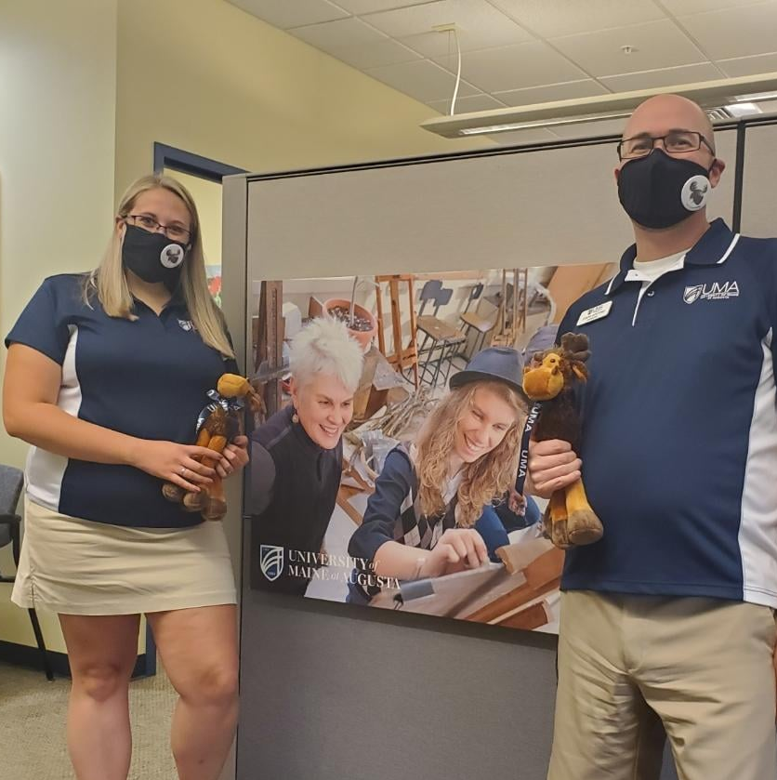
UMA Enrollment
Early College
(excludes EC)

Slide 15
UMF Enrollment
Early College
(excludes EC)

Slide 16
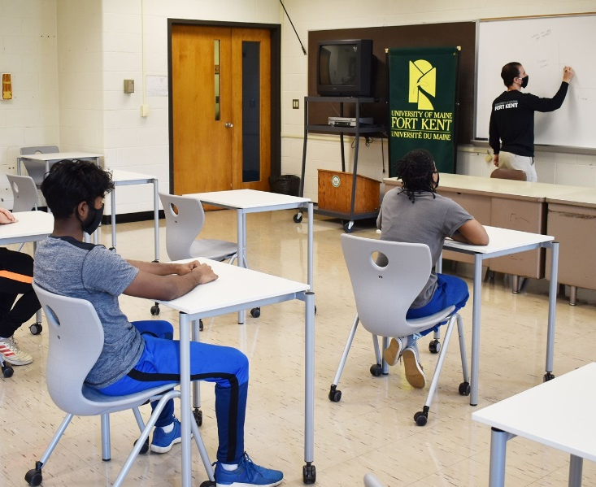
UMFK Enrollment
(excludes Early College)
Early College
(excludes EC)
AP

Slide 17
UMPI Enrollment
(excludes Early College)
Early College
(excludes EC)
AP

Slide 18
USM Enrollment
Early College
(excludes EC)
AP

Slide 19
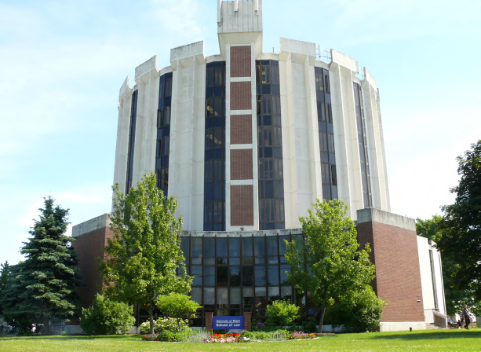
UM Law Enrollment

